Slide 1
How to Get published in major media outlets: Tips for Lawyers and Legal Professionals
A Webinar by PaperStreet

Slide 2
topics
Why Publishing Is Important
Steps to Getting Published in Major Media Outlets
How to Pitch Article Ideas
List of Legal Publications and Potential Markets

Slide 3
Why publishing is important
Boost Your Online Visibility
Gain Professional Credibility
Drive Traffic to your Website
Increase Search Rankings
Build Your Platform

Slide 4
Steps to Getting Published
Identify Publications to Pitch
Research Submission Guidelines
Develop a Strong Query
Write the Article
Build Relationships with Editors
Notes:
.

Slide 5
Research and identify publications
Recent Issues
About Us Page
Editorial Calendar
Media Kit
Articles
Author Bios
Advertisements

Slide 6
Research submission guidelines
Type of articles they accept
Process for submission
Style guidelines
Materials you must submit
Detailed bio
Portfolio of published articles
Query letter

Slide 7
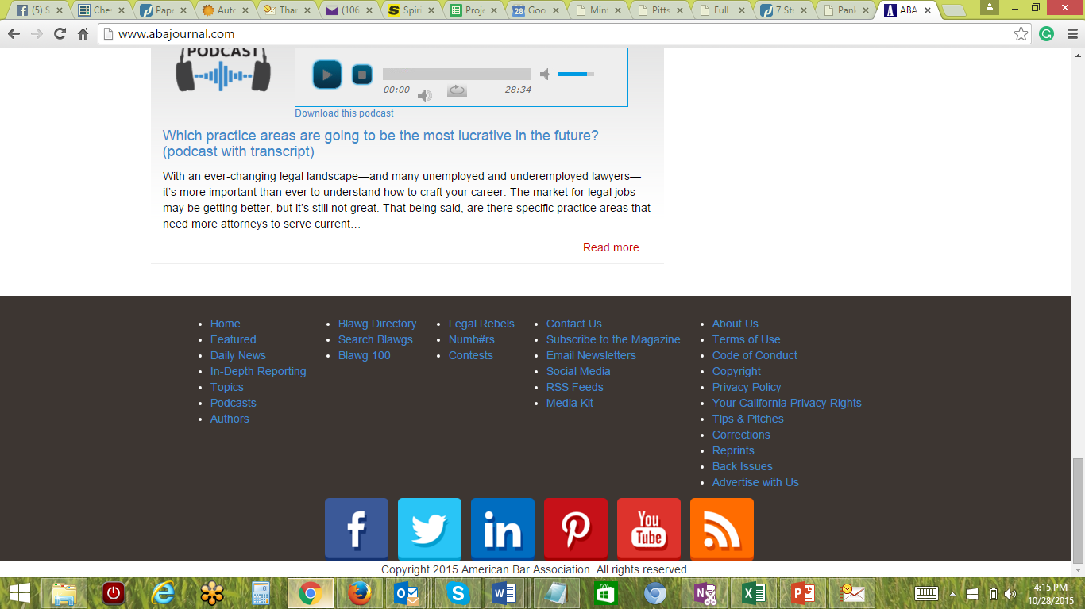
Example: ABA Journal

Slide 8
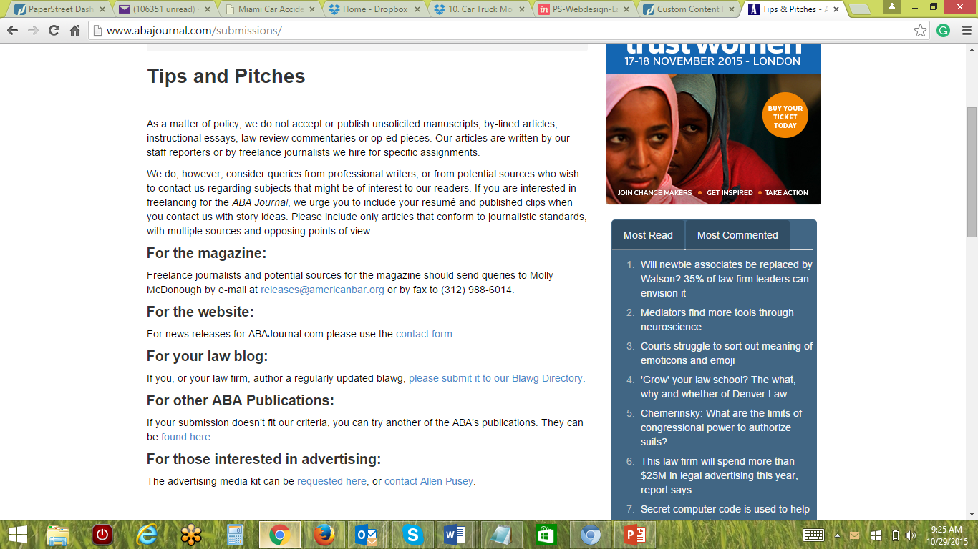
Example: ABA Journal
http://www.abajournal.com/submissions/

Slide 9
DEVElop a strong query LETTER
Stand out from the crowd
Targeted to the publication

Slide 10
Elements of a query letter
Personalization
Hook
Synopsis
Platform
Closing

Slide 11
Elements of a query letter: HOOK
Hook - strong opening sentence that grabs the reader
Breaking News
Controversial Angle
Inside Scoop
Fresh Approach
Notes:
.

Slide 12
Elements of a query letter: Hook
Weak: “I’d like to write an article for your publication about new trends in legal education.”
Better: “A quiet evolution is occurring within the nation’s law schools. A changing legal climate, fiscal constraints and burgeoning case loads are creating a market for law graduates who can hit the ground running.”

Slide 13
Elements of a query letter: SYNOPSIS
Synopsis - outline of the proposed article
Proposed title
Topics you will cover
Expert sources
Suggested word count
Where it will fit in publication or online channels

Slide 14
Elements of a query letter: SynoPSIS
My proposed article, “Education Innovation,” will discuss this new breed of legal education, incorporating insights from students, educators and law graduates. I will discuss some of the new skills-intensive offerings (such as transactional drafting and client management), the reasons behind the departure from doctrinal courses, and how graduates of these programs are faring in the legal marketplace. The article will also highlight a number of law schools that have espoused this new breed of legal education (or list them in a sidebar).

Slide 15
Elements of a query letter:
PLATFORM
Platform - Why are the right person to write this article?
Experience and Background
Published Clips
Honors, Awards, Accolades
Education
Professional Photo

Slide 16
Elements of a query letter: CLOSING
Closing
Brief wrap-up
Thank the editor

Slide 17
Writing the article
Follow the writing guidelines
Match style and tone to the publication
Always keep target readership in mind
Include links to your website and social media accounts
Never miss a deadline

Slide 18
Build relationships
Build relationships with editors, journalists and staff writers.
Never miss a deadline
Follow instructions
Be easy to work with

Slide 19
LEGAL PUBLICATIONS
Law Practice Today
Legal Intelligencer
Texas Lawyer
California Lawyer
Law Technology News
West Virginia Lawyer
Super Lawyers (pitch a profile)
Law Practice Management
ABA Journal
Litigation Support Today
GP Solo Magazine
Plaintiff Magazine
Managing Partner
Minority Law Journal
Pennsylvania Lawyer
Inside Counsel Magazine
Trial Magazine
Products Liability Law Reporter
Litigation Support Today
Legal Assistant Today
Know Magazine
Student Lawyer
IP Law & Business
Law Reporter
lawyerist.com
attorneyatwork.com
Jurist.org
Legalexaminer.com

Slide 20
Additional information
paperstreet.com/blog
facebook.com/paperstreet
@paperstreet
sally@paperstreet.com

