Slide 1
Internet Marketing Benefits
A PaperStreet Presentation
Notes:
Reinforce the importance of active social media accounts by explaining how they are critical to SEO

Slide 2
Alex DiSebastian
Allison Gagliardi
Internet Marketing Director
Content Editor
alex@paperstreet.com
allison@paperstreet.com

Slide 3
Agenda
Core Content
Blogging
Social Media
Google +
Business Page/Local
Profile/Authorship Page(s)
YouTube

Slide 4
Your tools for establishing industry dominance:
Social media Networking
Blogging Standards
Authorship / Local Best Practices
Notes:
[explain the three ways you can achieve that goal]
Once you have established the topic you seek to dominate you need to turn your attention to social media, blogging and authorship. All three bolster your relevancy and therefore, SEO results and conversions.

Slide 5
The goal of your seo campaign is to be the industry leader
Notes:
[define the purpose of a SEO campaign]
The goal of every SEO campaign is to be the industry leader in your area and on your topic. The top authoritative figure; the ultimate resource all while establishing your brand and identity.
The foundation for all campaigns are keyword phrases.

Slide 6
WEBSITES
This is your:
- Content
- Search
- Blogs
- Social Media
- Videos
- Everything Else
Your website is the
base of all your marketing

Slide 7
Core Content

Slide 8
WEBSITES: CONTENT
Goal
Become an Authority.
Unique. Don’t Duplicate.
Make it Contextually Relevant.
Don’t Copy or Steal.
What to Write About
Don’t just write about You, You and You.
Write what your Clients Want to Read
Facts, Q&A, How To, Case Studies, Top 10 Lists.
Notes:
[briefly explain blogging best practices]

Slide 9
Blogging

Slide 10
Blogging best practices
Create quality content
Format for the web
Write for your reader
Optimize your posts
Write catchy headlines
Aim for 500-700 words
Post regularly
Avoid duplicate content
Cross-promote
Incorporate visual aids
Notes:
[briefly explain blogging best practices]

Slide 11
WEBSITES: BLOGS
Topics
News
Court Rulings, Legislation, Industry News, Trends, Cases
Informative
Case Law Analysis
Client Questions
FAQs
Process
Announcements
Firm News, Success, Awards
Schedule
Publish Daily.
Yes. Publish Daily.
Very Least Publish Weekly
Big Long List
http://www.paperstreet.com/blog/5047
Notes:
[briefly explain blogging best practices]

Slide 12
Social Media

Slide 13
WHO WOULD YOU Feel more comfortable contacting?
Notes:
[show proof]
& when done correctly, your audience turns to you as a resource over your competitor.

Slide 14
USE SOCIAL MEDIA BRANDING AS AN “ELEVATOR PITCH” TO NEW AND EXISTING CLIENTS
FOLLOW
LIKE
SELL
CONVERT
Notes:
[provide a literal example]
We like to say that your social media accounts are an elevator pitch to your potential clients. They (potiental clients) are already their (they are in the elevator / have a Facebook account), your job is reach out to them.

Slide 15
Google +

Slide 16
WHY LOCAL MATTERS
Proper category association
Physical address in city
Owner verified Local Page
exact Address on website
Proximity of address to area of interest
Notes:
[explain local listings and the importance of telling Google where you live]

Slide 17
WHY Authorship MATTERS
Website is a publishing platform
Being the “Face” for the company
Authorship vs. Publisher
More likely to click on authorship than other topped ranked sites
Author Rank
Notes:
[explain local listings and the importance of telling Google where you live]

Slide 18
Video Blogging

Slide 19
Video Blogging
Set up a YouTube Channel Now
Google takes videos seriously
53x times more likely to be clicked
Relevancy & Authority
Notes:
[explain local listings and the importance of telling Google where you live]

Slide 20
Why this is important for YOUR firm
ATTRACT NEW AND EXISTING CLIENTS
Increase BRAND Loyalty and Emotional Attachment
DEVELOP BRAND AWARENESS and recognition
Differentiate YOUR BRAND
build credibility
Notes:
[explain why you should care about social media / establishing yourself as an authority]
You need to care about social media. Think of it as a leg to a chair - without a leg you fall down.
It’s a no brainer that businesses need to have accounts on the major networks to build credibility, establish your brand and connect with your audience/customers on a more casual level, but the reap the benefits of those things you have to put the work in to build an audience and online reputation by contributing regular, meaningful content in the formats that your audience expects it.

Slide 21
CLIENT EXAMPLES
Notes:
[client examples]

Slide 22
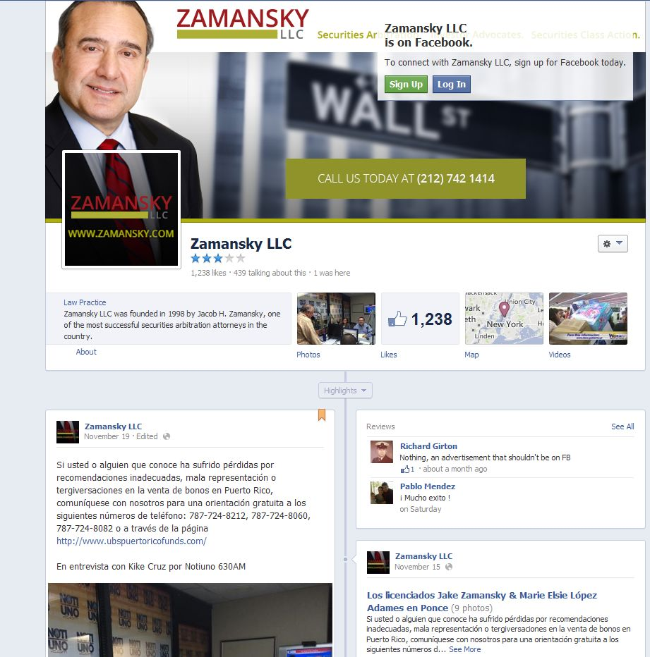

Slide 24
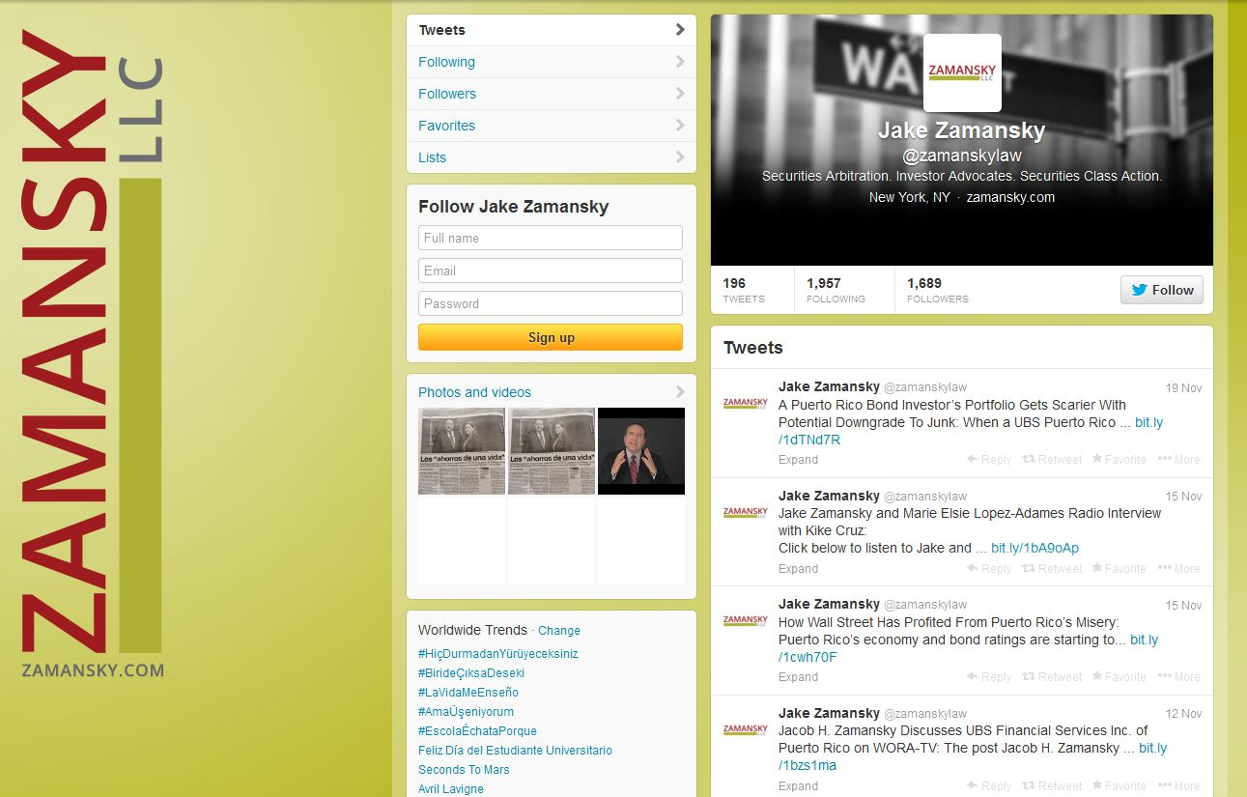

Slide 25
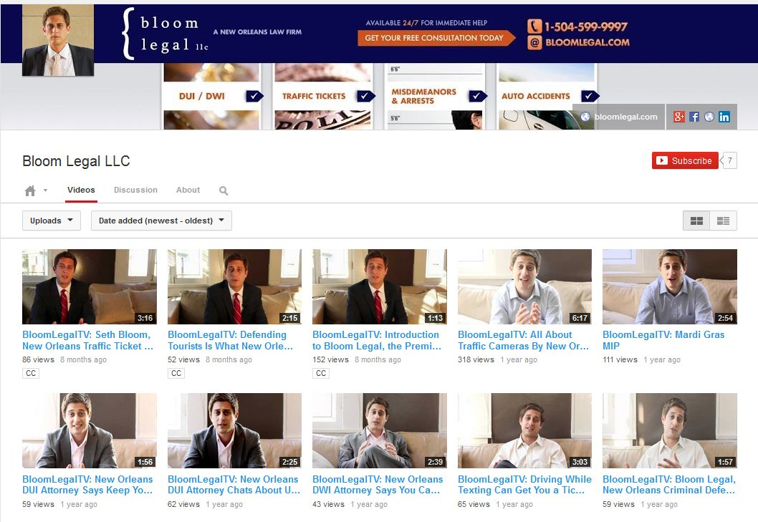
Notes:
[explain local listings and the importance of telling Google where you live]

Slide 26
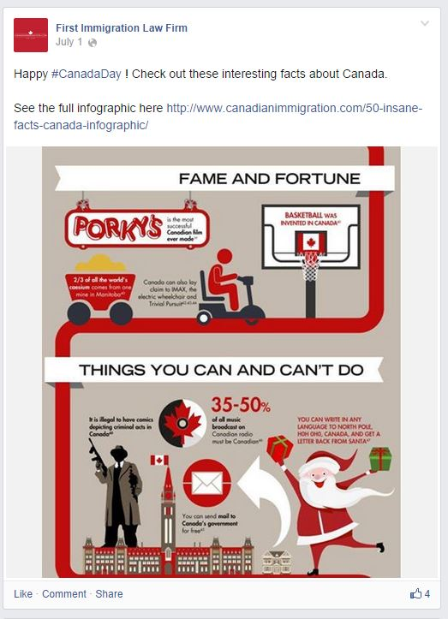
Notes:
[explain local listings and the importance of telling Google where you live]

Slide 27
Notes:
[explain local listings and the importance of telling Google where you live]

Slide 28
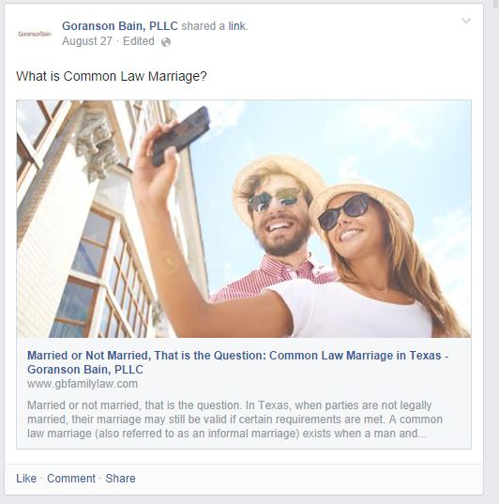
Notes:
[explain local listings and the importance of telling Google where you live]

Slide 29
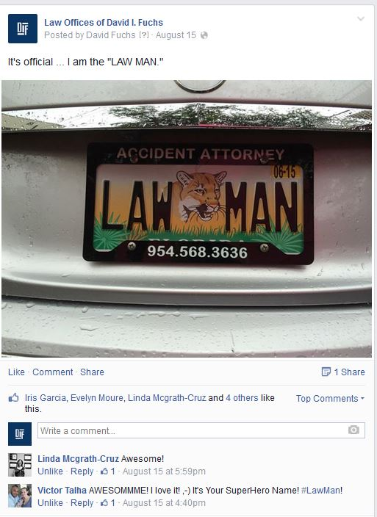
Notes:
[explain local listings and the importance of telling Google where you live]

Slide 30
Notes:
[explain local listings and the importance of telling Google where you live]

Slide 31
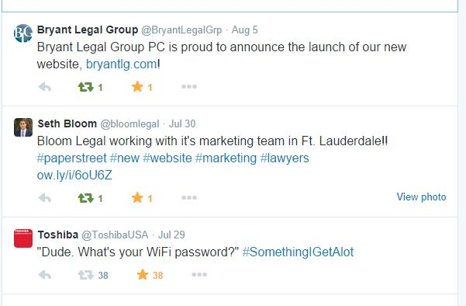
Notes:
[explain local listings and the importance of telling Google where you live]

Slide 32
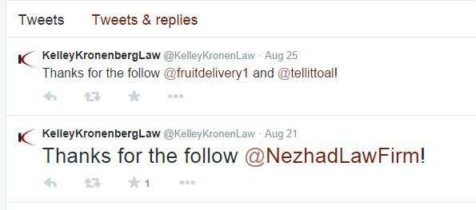
Notes:
[explain local listings and the importance of telling Google where you live]

Slide 33
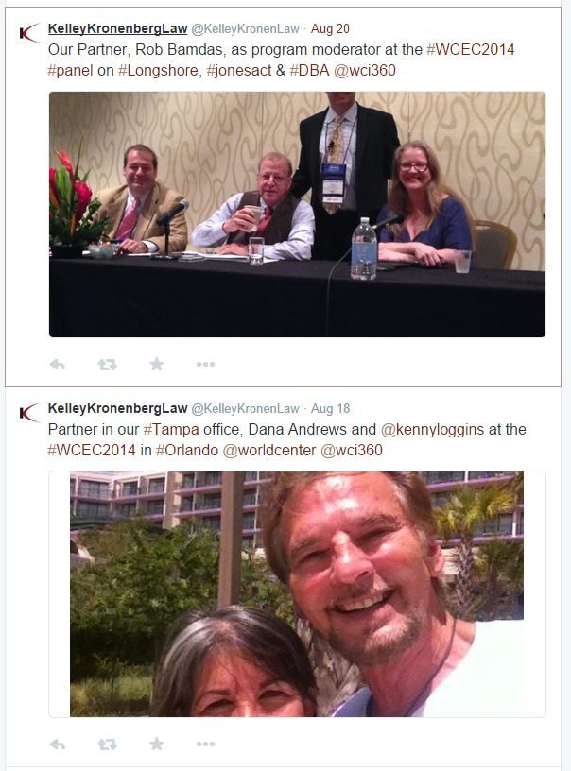
Notes:
[explain local listings and the importance of telling Google where you live]

Slide 34
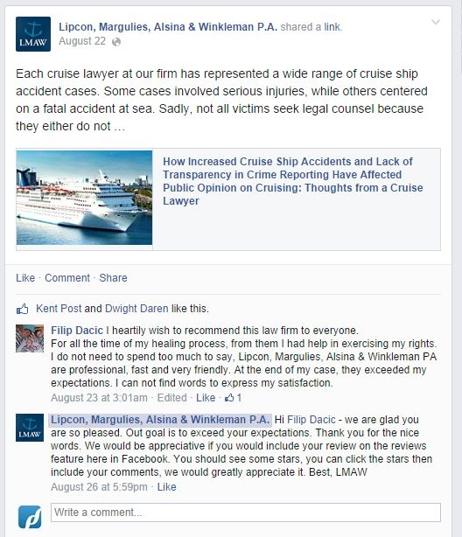
Notes:
[explain local listings and the importance of telling Google where you live]

Slide 35
Food for thought
Do users have a hard time finding your company on social networks?
Is it difficult to differentiate your company on social networks?
Are your SMO accounts generating leads?
Are users actively involved in your social networks?
Do you need help identifying your social target demographic?
Are you giving your competitors a run for their money?
Notes:
[provide criteria for a self evaluation]
Don’t worry – we did this for you.

Slide 36
resources
The Best Websites to Spark Ideas for Social Media Posts
10 Blogging Best Practices for Law Firms and Businesses
Five Don’ts of Social Media for Law Firms
Social Media Topics for Law Firms
Video Marketing – How it Works And Why to Use It
Notes:
[resources for more informtation]

Slide 37
SUMMARY
A STRONG SOCIAL MEDIA PRESENCE
=
HIGH RANKINGS
MORE CONVERSIONS
BETTER BUSINESS
________________________
HAPPY LAWYERS &
INTERNET MARKETING TEAM
Notes:
[summary of presentation]

