Slide 1
Websites and
Your Firm’s Web Presence
By Peter Boyd, Esq.
Attorney & General Guru
PaperStreet Web Design

Slide 2
Why Market & Brand You?
Get Clients:
  Make Partner
  Start Own Firm
  Hire your Own Associates
Become an Authority Online
  Search Results
  Speaking Engagements
  Interviews

Slide 3
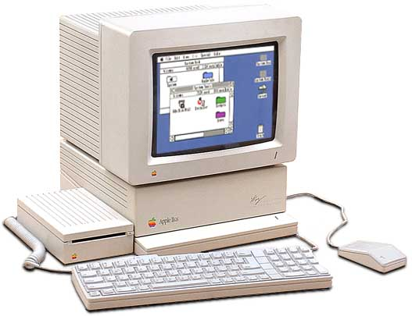
I am a Geek
Peter T. Boyd
My First Computer (circa 1986)
Attorney (Florida Bar 2001)
Practiced IP Law
My True Love: Computers
Petitioned UF Law to allow Programming in C as a Foreign Language class.
Founder of PaperStreet in 2001
Helped 750+ Law Firms
@peteboyd on Twitter
On Google+, FB and LinkedIn too

Slide 4
What is Internet Marketing?
Your Website
Getting Traffic to your Site
  Search Engine Optimization (SEO)
  Paid Ads
  Newsletters
  Content Marketing
  Social Media Optimization
Converting Traffic to Leads

Slide 5
Why Internet Marketing?
Everyone is Online
&
It Really Works.

Slide 6
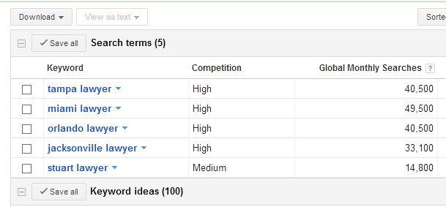
Why Internet Marketing?
Tens of Thousands of Searches Per Month!

Slide 7
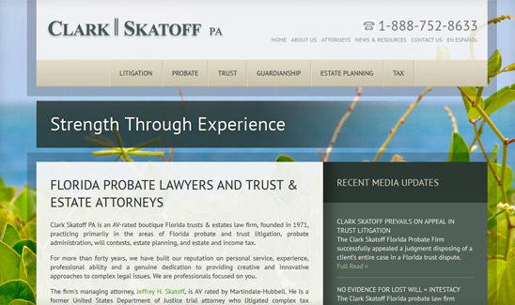
Online Results: Case Study #1
Firm: Clark Skatoff, PA
Type: Small Firm
Practice: Probate
Results:
2 to 4 inquiries / day
5 to 10 new clients / mo
Tactics: Website, SEO, Blogging, and Articles

Slide 8
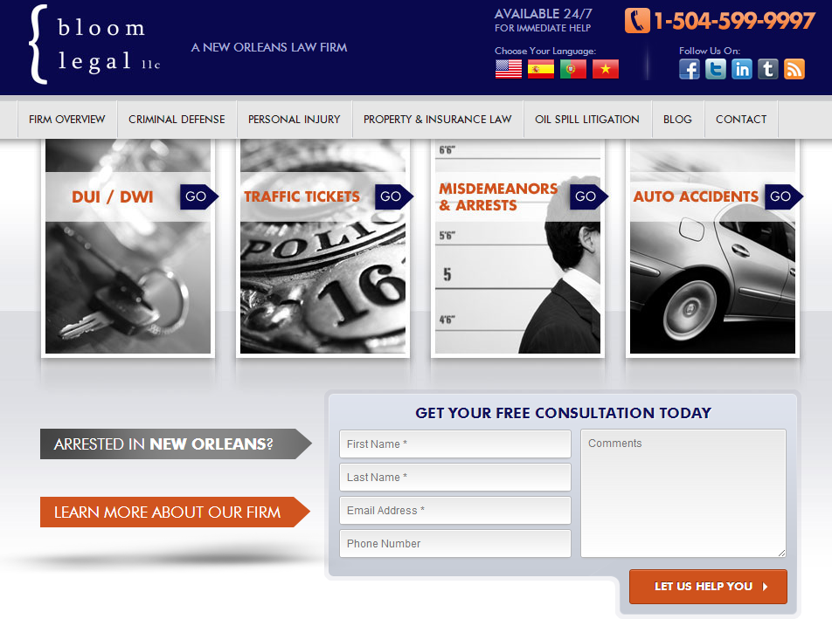
Online Results: Case Study #2
Firm: Bloom Legal
Type: Solo Practitioner
Practice: Criminal Law
Result:
2 to 3 inquiries/ day.
Tactics: Website, Blogging, Articles, Social Media, and Pay-Per-Click

Slide 9

Before We Start: The Bar Rules
All Advertisements are Covered, including:
  Websites
  Video, TV & Radio
  Print
  Brochures
  Direct Mail & Email
  Sanskrit, Signal Flags, Hieroglyphics, and Other Forms of Communication.

Slide 10
Bar Rules: Top 10 Things
Objectively Verifiable.
Don’t Use Superlatives Without Proof.
Testimonials are Allowed (with disclaimer).
Past Results are Allowed.
Websites & Social Media Same as Other Ads!
Requests for Info are Exempt from Filing / Review.
Websites do NOT need to be Reviewed.
Brochures are Requests for Information.
Burden of Proof on the Bar to Prove a Statement is False or Misleading.
Contact Information Needs to be on All Ads.

Slide 11
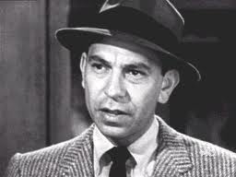
Bar Rules: Verifiable & Superlatives
Objectively Verifiable
  Basically, Don’t Lie.
  If you make a claim,
  back it up!
Don’t Use Superlatives, “Just the Facts, Ma’am.”

Slide 12
Bar Rules: Verifiable & Superlatives
Good Examples:
Practicing for 10 years.
Licensed in 3 States.
Helped 150 people with their foreclosures.
Uh Oh!
Best Lawyer in Town.
The Toughest Lawyer around.

Slide 13




Bar Rules: Social Media & Websites
Testimonials – Go ahead and place on website. Just make sure they have a disclaimer and are verifiable.
Past Results – Again, put on website, but make sure they are verifiable.
Social Media – Must have Contact Information on profiles (and possibly in the posts).

Slide 14
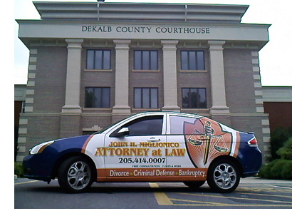
What is Branding?
Online: Website, Social Media, SEO
Print: Letterhead, Cards, Envelopes, Brochures
Offline: Your Attire and Office (even your car)

Slide 15
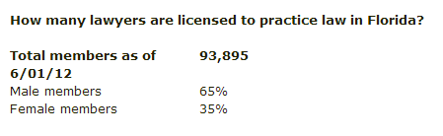
Why Brand Yourself?
Establish a Professional Image
Get Known for Something
Separate you from the Competition
That is a lot
of competition.

Slide 16
What Makes a Good Brand?
  Consistency: Used on Everything.
  Clarity: Key Message is Clear.

Slide 17
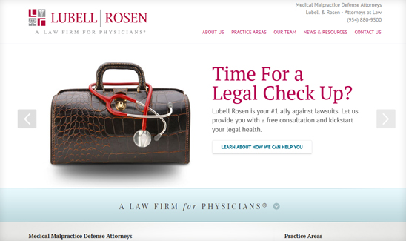
Key Message of the Brand:
Law Firm for Physicians

Slide 18
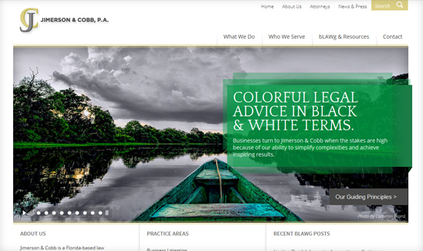
Key Message of the Brand:
Simple Advice

Slide 19
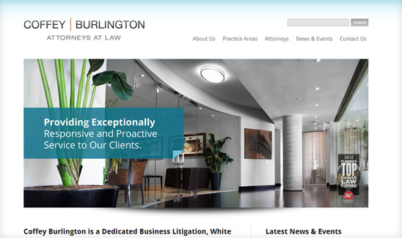
Key Message of the Brand:
Responsive and Proactive

Slide 20
Tactics Used to Market Your Firm
Websites
Content Marketing
SEO
Local Search
Newsletters
Advertising
Social Media
Directories
Videos
Conversions & Analytics

Slide 21

Websites
This is your:
- Content
- Search
- Blogs
- Social Media
- Videos
- Everything Else
Your website is the
base of all your marketing

Slide 22
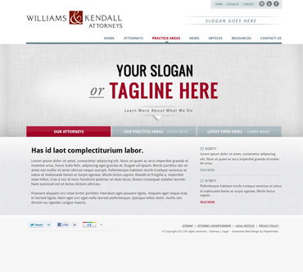
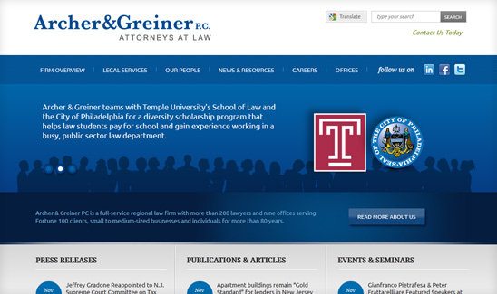
Websites: Custom vs. Template
Custom
Unique & Branded
More Detail
More $$$ & Time
Template
Solid Design
Less Detailed
Cost Effective & Quick

Slide 23
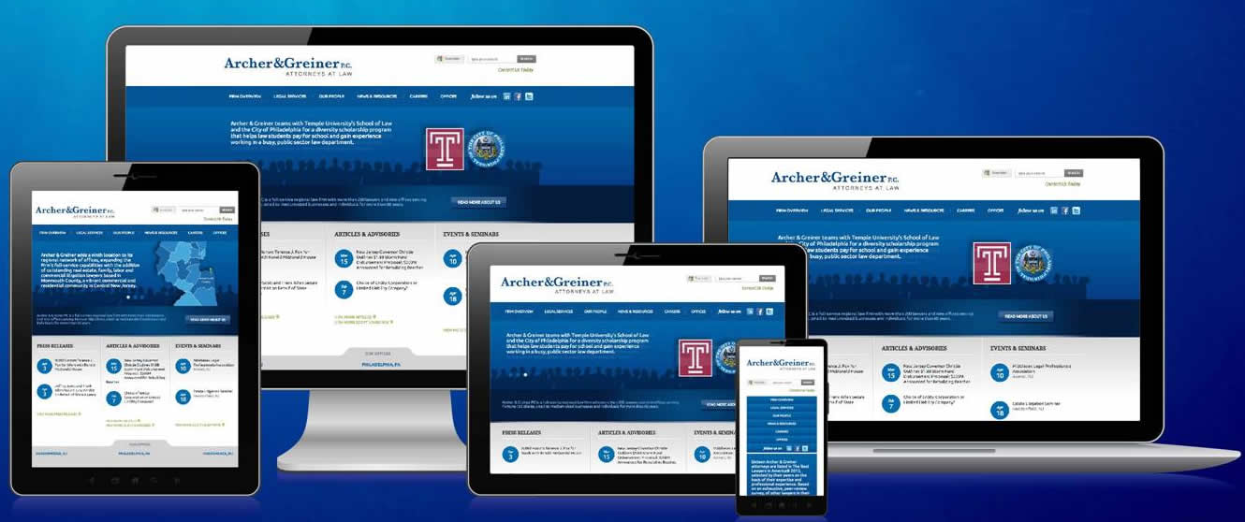
What is Responsive Design?

Slide 24

Types of Responsive Design

Slide 25

Websites: Content System & Platform
Make Sure you Have One.
Easy to Use.
Allows you to Add, Edit, Delete pages.
Allows you to Blog and Post to Social Media.
Publish Weekly, Ideally Daily.
We Personally Use:
  Wordpress (Open-Source, Free, Easy-to-Use)
  Total Control (our own development for law firms)
  Others: Joomla, Drupal, and Expression Engine.

Slide 26
Websites: Domains
Use a .com
Keep it Short, Simple
Avoid Plurals (hard to say)
Hyphens are Allowed (keep to 2 or less)
For Branding – Contain your Name
For Search - Contain Keyword Phrases
301 Redirect All Others into Dominant Domain

Slide 27
Websites: Domain Examples
Branded:
ADDMG.com (acronym)
McConnaughhay.com (main partner name)
Keyword:
florida-probate-lawyer.com
StockBrokerLitigation.com
TampaTrialLawyers.com
DisabilityAttorney.net

Slide 28
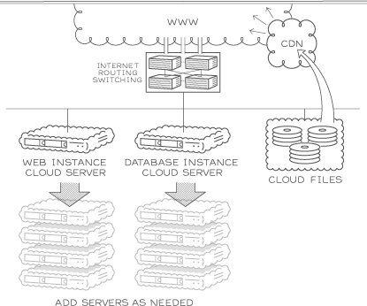
Websites: Hosting
Hosting & Email
Typically Provided by your Web Team
Included in Monthly Fees
We personally use:
  Rackspace.com
  MediaTemple.net
  Google Apps for Email
  Godaddy, too.
Support is Key
Courtesy of rackspace.com

Slide 29

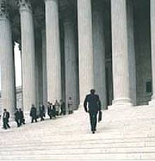

Websites: Images
Use Royalty Free, Stock Photos
Don’t Steal Images from Google Search
Where to Go: www.istock.com, www.gettyimages.com, www.corbis.com, www.veer.com, and others.
Key Message on Home Page with Good Image
Don’t use Clichés (Gavels, Courthouse Steps)

Slide 30
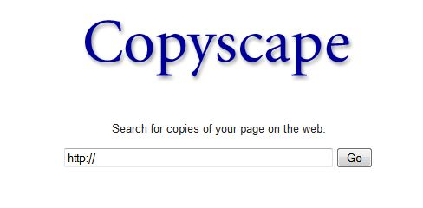
Websites: Content
Goal
  Become an Authority.
  Unique. Don’t Duplicate.
  Make it Contextually Relevant
  for what you want to be.
  Don’t Copy or Steal.
  Have a Site Structure.
What to Write About
  Don’t just Write about You, You and You.
  Write what your Clients Want to Read
  Facts, Q&A, How To, Case Studies, Top 10 Lists.

Slide 31
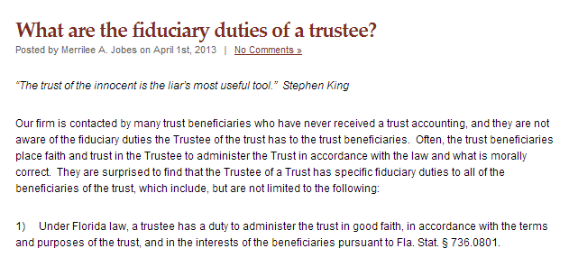
Websites: Blogs
Topics
News
  Court Rulings, Legislation, Industry News, Trends, Cases
  Informative
Case Law Analysis
Client Questions
  FAQs
  Process
  Announcements
Firm News, Success, Awards
Schedule
Publish Daily.
Yes. Publish Daily.
Very Least Publish Weekly
Big Long List - http://www.paperstreet.com/blog/5047

Slide 32
Website Big Ideas
Elegant Design, Lose the Clutter.
A Few Seconds to Impress, Get to the Point.
Make One Website, and put Everything Under.
Keep it Updated!
Abide by the Bar Rules.

Slide 33
Top 18 Ways to Improve Your Website
Design
  Message: Have a clear message, powerful tagline and crisp logo.
  Brand: Have a unified brand across all your websites and print materials.
  Typography: Enlarge headlines and paragraphs for information hierarchy.
  Imagery: Feature imagery that best represents your brand.
  Content: Feature your most important content on the home page.
  Structure: Create an organized structure for your website.
Technology, Usability & Platform
  Content System: Make it easy to update your website.
  Errors: No missing pages or broken links.
  Build: Make your website W3C compliant and full HTML.
  Tools: Submit your site to Google Webmaster Tools, Sitemaps and Analytics.
  Size: Make your site at least 960 pixels wide and have clear rollovers.
  Blog: Make sure you blog. Become an authority in your area.
Marketing
  Calls to Action: Include your contact information in header, footer & sidebar.
  SEO: Build Links to your website and properly tag your site’s web pages.
  Social: Integrate Social Media into your website and network.
  Content: Write regularly. Become an authority in your area.
  Mobile: Create a mobile version of your website or “Responsive Design.”
  Paid: Consider paid ads online to increase traffic and convert users.

Slide 34
Design Improvements
Message: Have a clear message, powerful tagline.
Brand: Have a unified brand across all materials.
Typography: Enlarge headlines and paragraphs.
Imagery: Use imagery that represents your brand.
Content: Place important content on home page.
Structure: Create an organized structure.

Slide 35
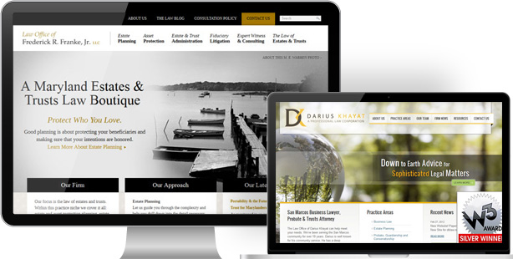
Design: Message
A Clear Message & Powerful Tagline.

Slide 36
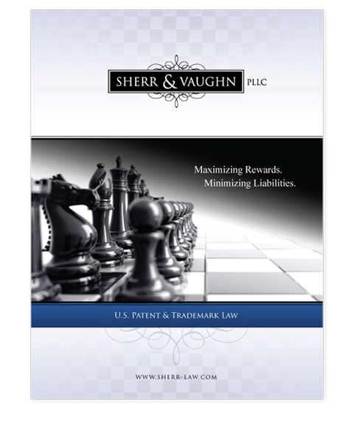
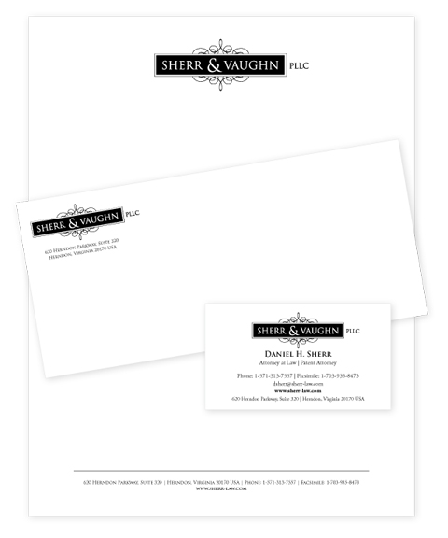
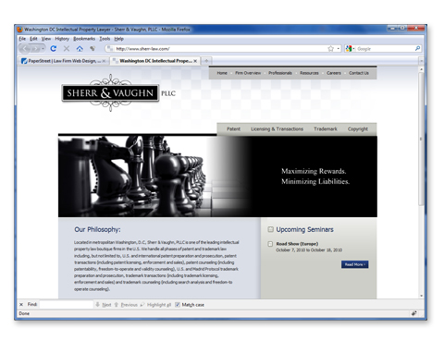
Design: Brand
A Unified Brand Across All Materials.

Slide 37
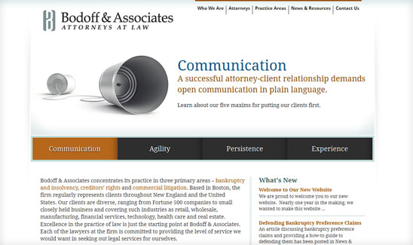
Design: Typography
Enlarge Headlines and Paragraphs.

Slide 38
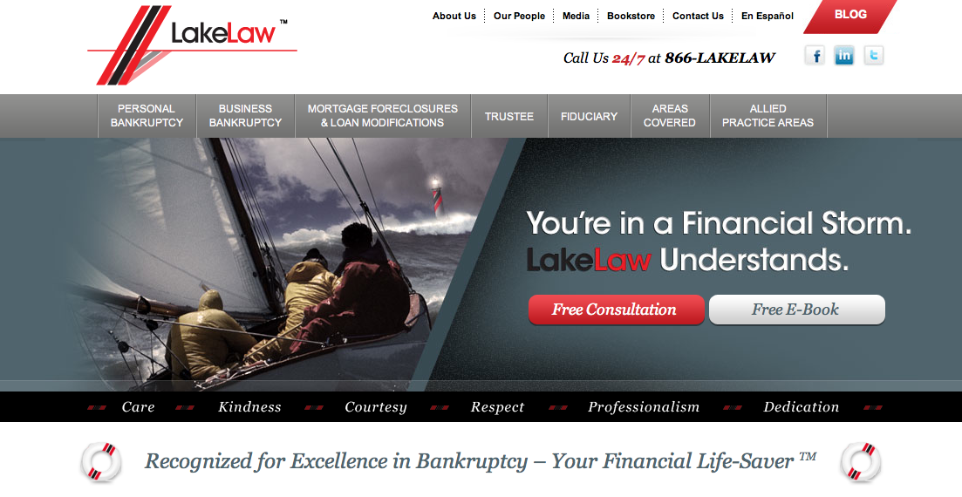
Design: Imagery
Feature Imagery that Represents your Brand.

Slide 39
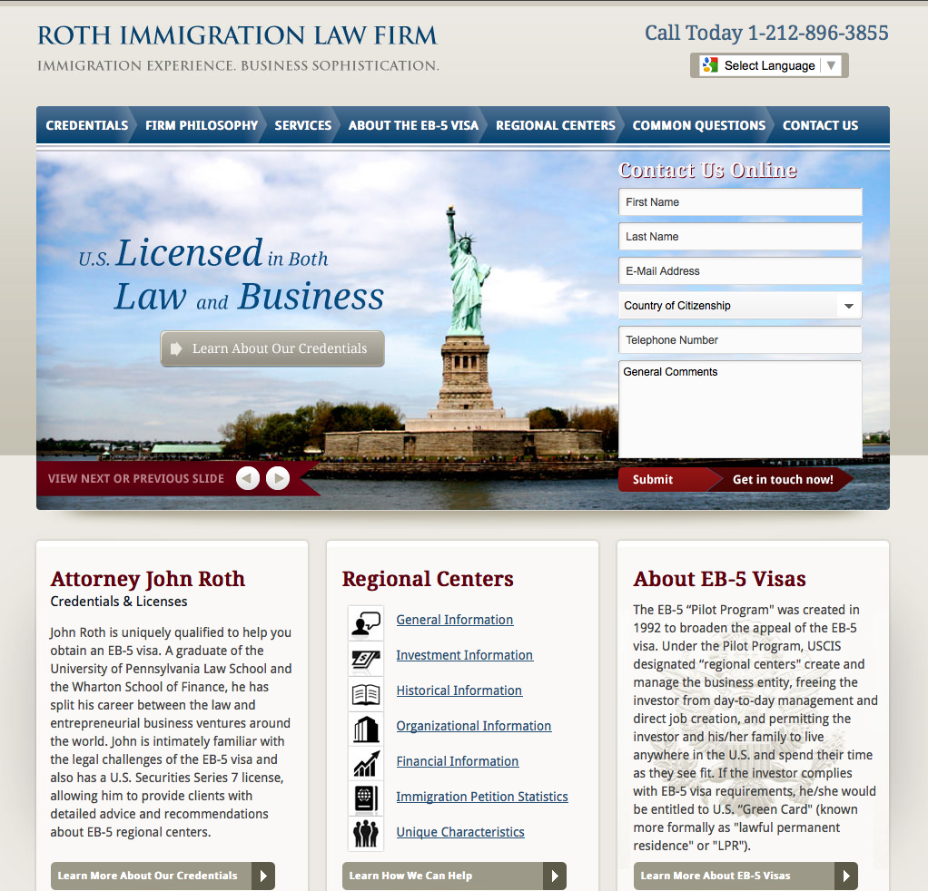
Design: Content
Most Important Content on the Home Page.

Slide 40
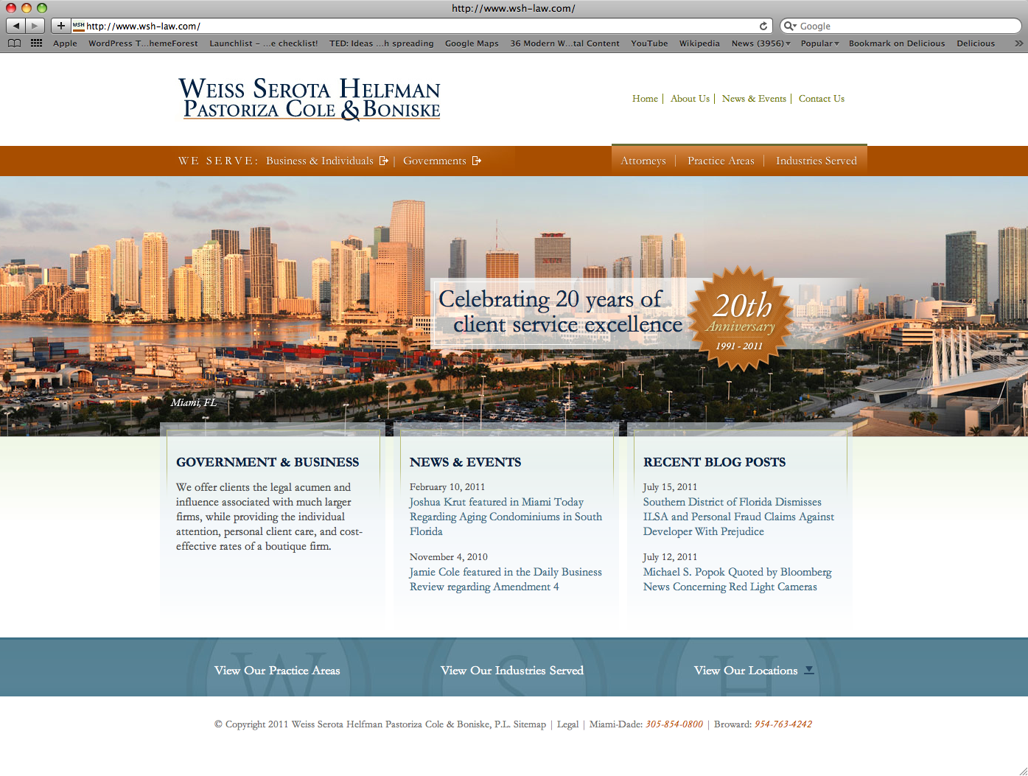
Design: Structure
Create an Organized Structure.

Slide 41
Technology Improvements
Content System: Make it easy to update your website.
Errors: No missing pages or broken links.
Build: Make your website W3C compliant.
Tools: Submit your site to Google Webmaster Tools, Sitemaps and Analytics.
Technology: Make your site at least 960 pixels wide and have clear rollovers.
Blog: Make sure you blog. Become an authority in your area.

Slide 42
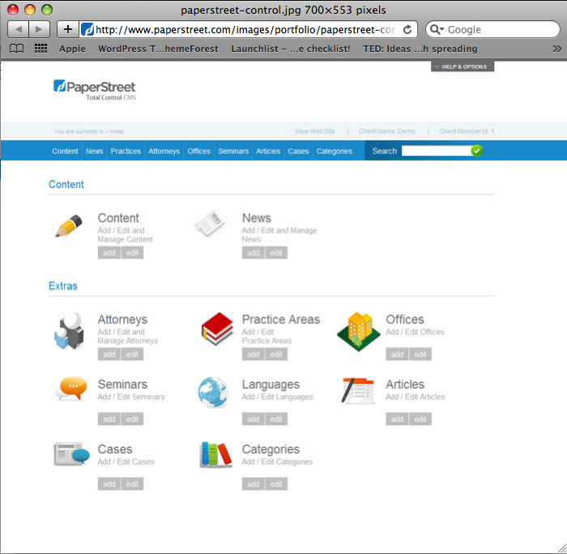
Technology: Content System
Make it Easy to Update your Website.

Slide 43
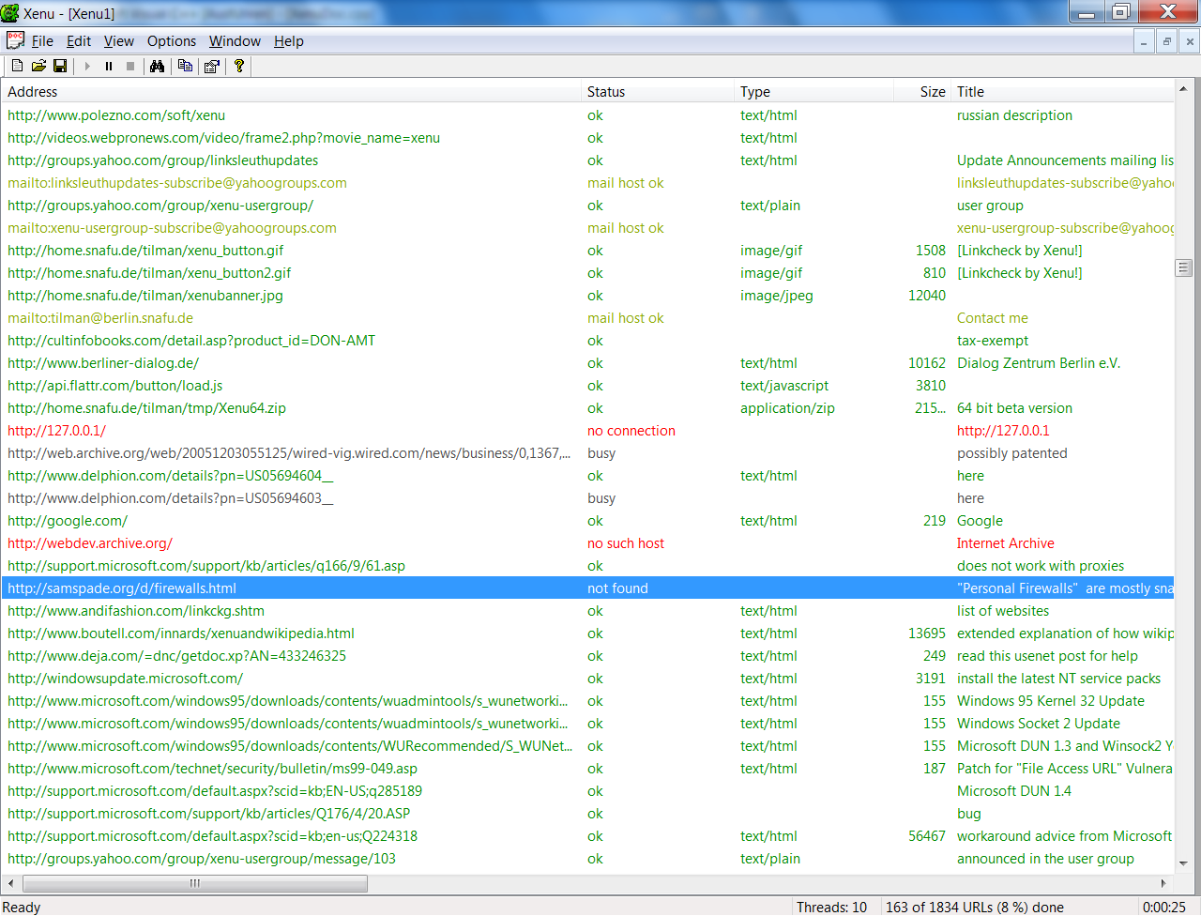
Technology: Errors
No Missing Pages or Broken Links.
http://home.snafu.de/tilman/xenulink.html

Slide 44
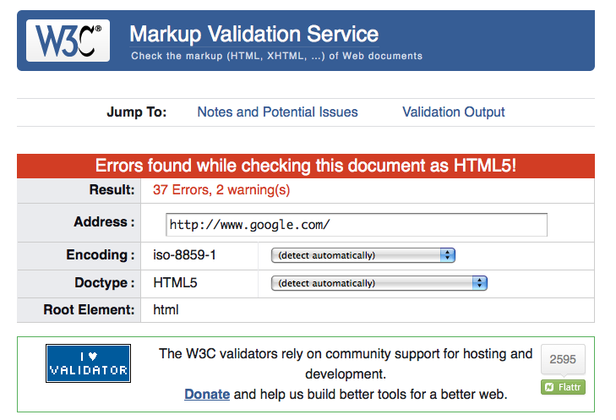
Technology: Build
Make your Website W3C Compliant.

Slide 45
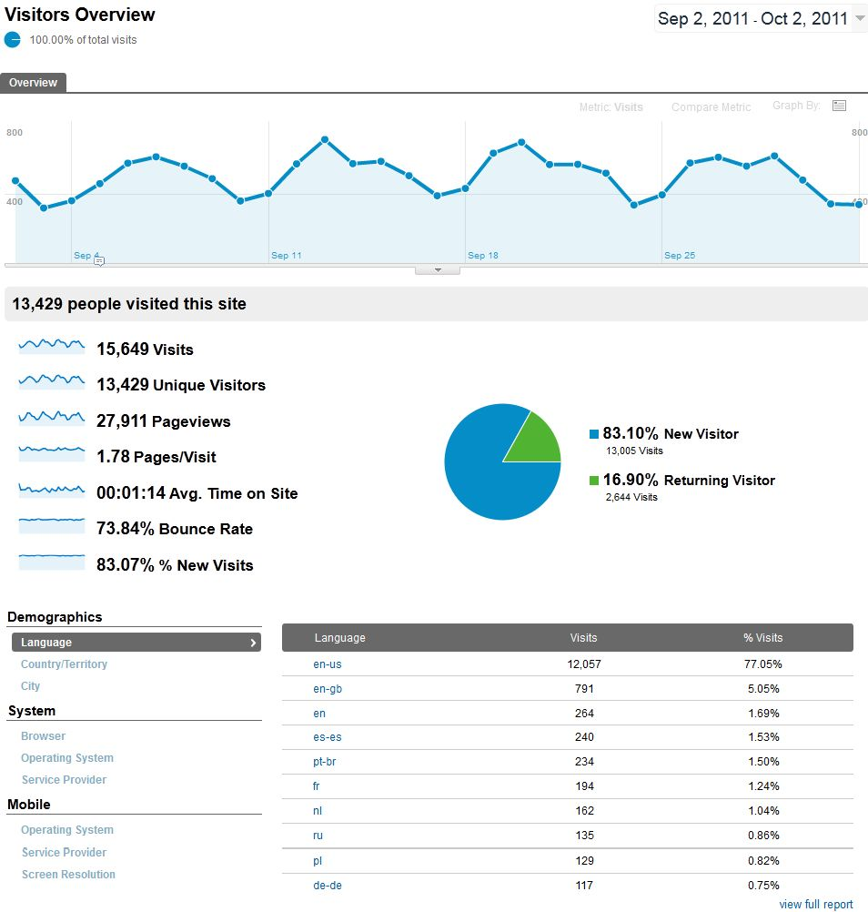
Technology: Tools
Submit your Site to
Google Webmaster Tools, Sitemaps & Analytics
Analytics

Slide 46
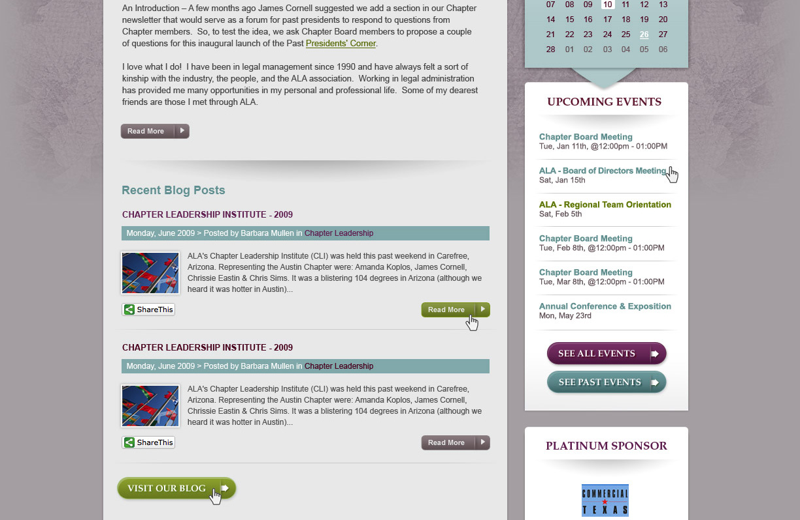
Technology: Size
At least 960 Pixels Wide with Clear Rollovers.

Slide 47
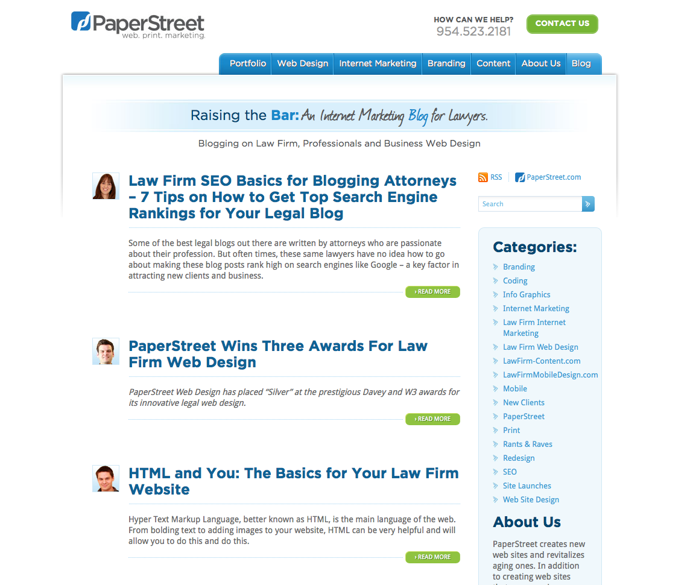
Technology: Blog
Make sure you Blog.
Become an Authority in your Area.

Slide 48
Marketing Improvements
Calls to Action: Include your contact information in header, footer & sidebar.
SEO: Build Links to your website and properly tag your site’s web pages.
Social: Integrate Social Media into your website.
Content: Write regularly. Become an authority.
Mobile: Create a mobile version of your website or “Responsive Design.”
Paid: Consider paid ads online to increase traffic.

Slide 49
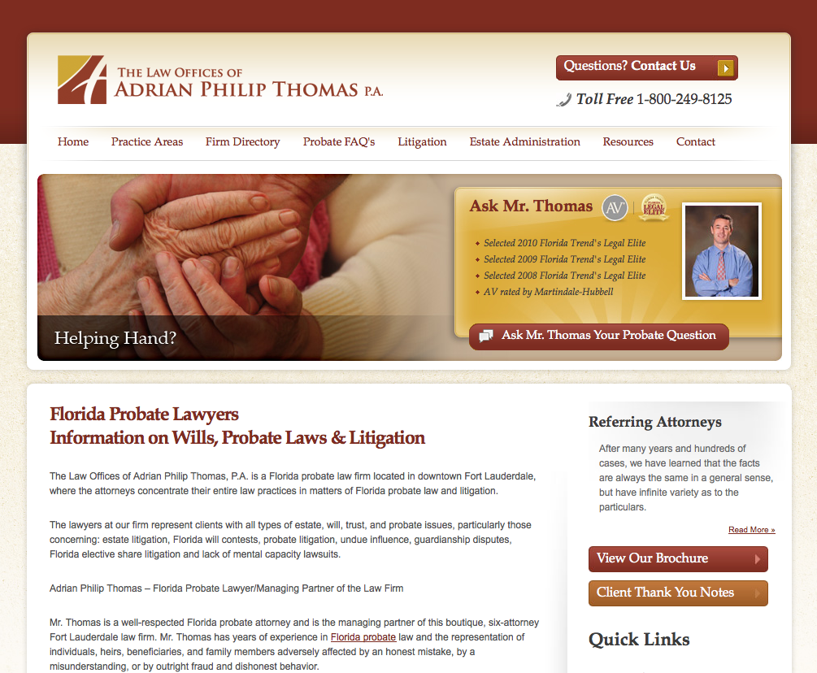
Marketing: Calls to Action
Include your Contact Information in Header, Footer & Sidebar.

Slide 50
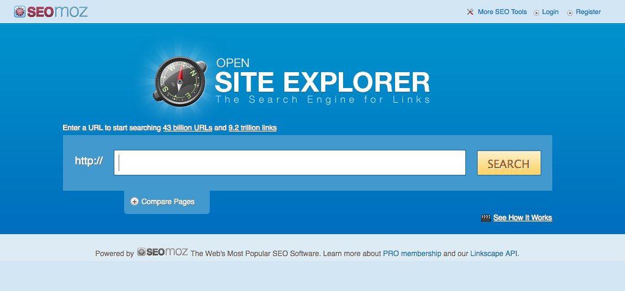
Marketing: SEO
Build Links to your Website.
Properly Tag your Site’s Web Pages.

Slide 51
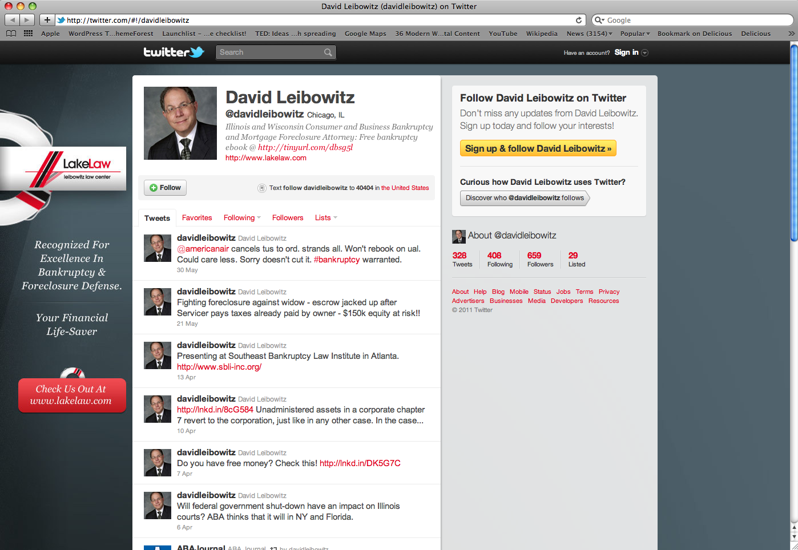
Marketing: Social
Integrate Social Media into your Website.

Slide 52
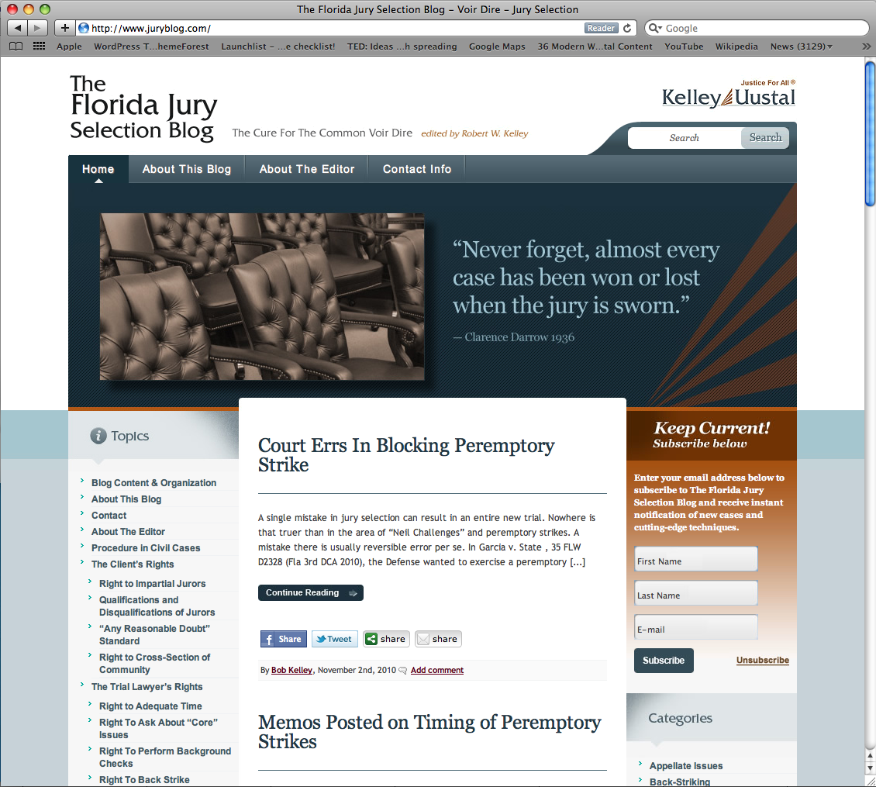
Marketing: Content
Write Regularly.
Become an Authority in your Area.

Slide 53
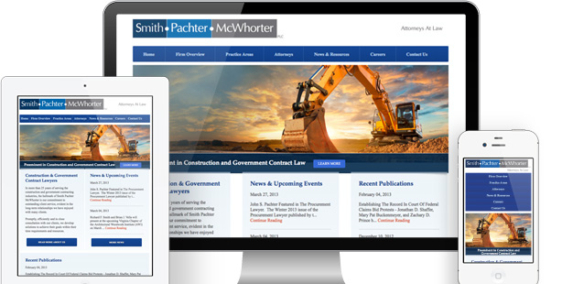
Marketing: Mobile
Create a Mobile Version of your Website or “Responsive Design.”

Slide 54
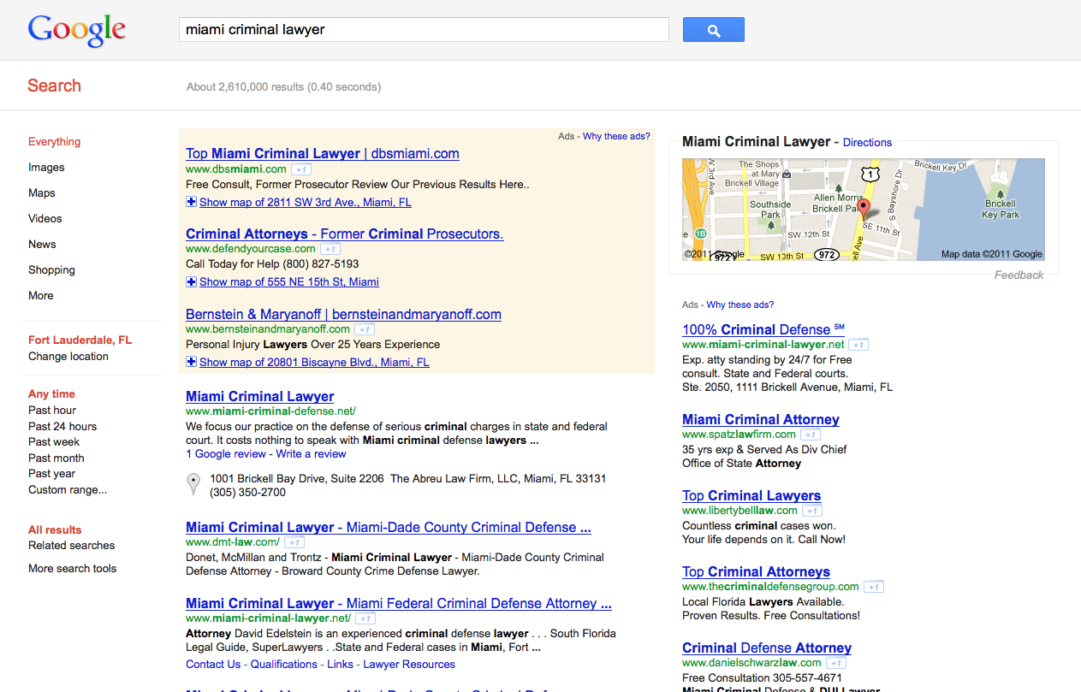
Marketing: Paid
Consider Paid Ads Online to Increase Traffic and Convert Users.

Slide 55
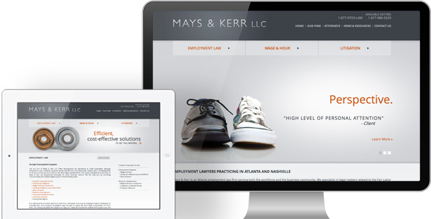
Content Marketing
  Write often.
  Cover legal news / events in your area.
  Create in-depth articles that help.
  Have the most exhaustive resource in your practice.

Slide 56
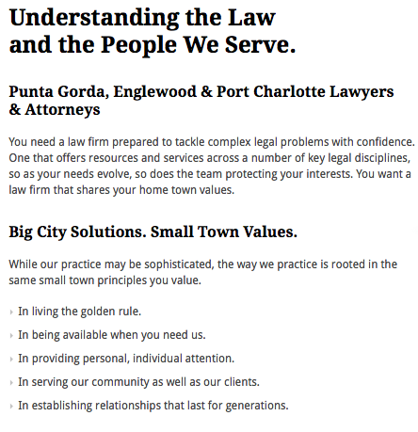
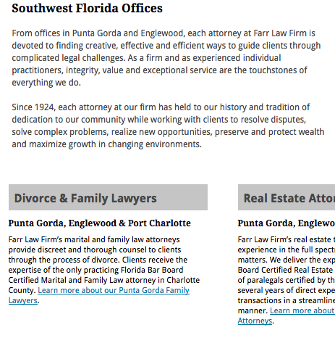
Online Reading Habits
Readers skim; they don’t read. Snap Decisions.

Slide 57
You are Too Wordy
Use bullet points and short paragraphs for skimming.
Make your content client-centric.
Use tables, charts, maps, lists, images, and diagrams, rather than text.
Use images and icons, rather than words.
Use headlines and sub headlines

Slide 58
Content Rules
Create a style and tone for your website.
Break up the pages.
Short sentences are better than long ones.
Keep SEO in mind. Be relevant.
Write for your Reader: Who do you foresee reading this content? Write for them, not for you. Avoid industry terms unless your targeted reader will already know them.

Slide 59
Duplicate Content & Structure
Unique content is key.
Don’t steal and don’t regurgitate.
Pyramid Structure
3 Levels are usually enough, sometimes 4.
50 or 100 Links per Page
Standard Pages:
Home, Practice, Attorneys, Blog, About, & Contact
Advanced Pages
Industries, News, Media, Case Studies, Articles, Directory of Resources, Lists, Charts, Industry information, and more

Slide 60
Content Ideas
About Us
Practice Areas and Info
Service Areas and Info
Products and Info
Lists
Top 10
News
Articles
Recommendations
Directory of Resources
Research Articles
Interviews
Free Tools
Expositions
Humor
Reviews
Video, Audio
Surveys
Contests
Trends
Advice Columns
Charts & Graphics

Slide 61
Content Marketing Tips
Readers skim; they don’t read.
Readers make snap decisions.
Use bullet points and short paragraphs.
Make your content client-centric.
Use tables, charts, maps, lists, images, and diagrams, rather than text.
Use images and icons, rather than words.
Use headlines and sub headlines

Slide 62
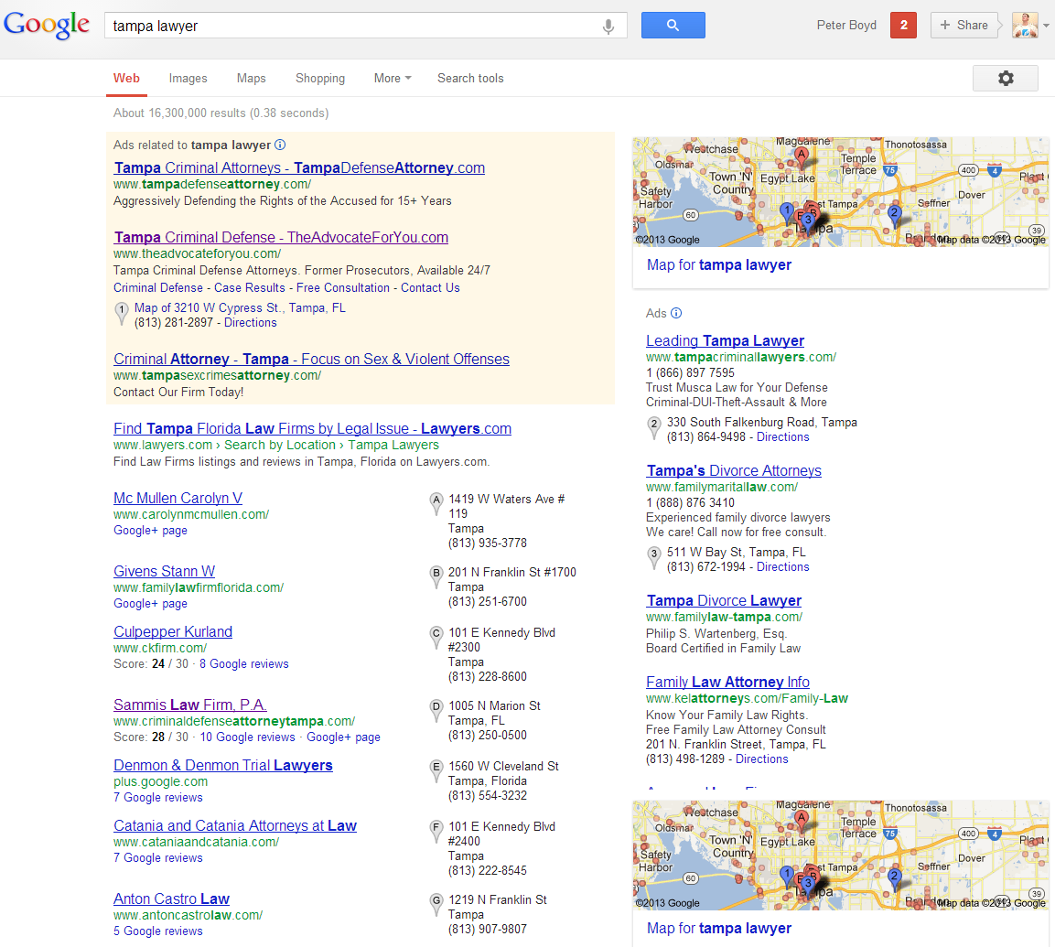
SEO: Search Engine Optimization
You Need to
Be Here!!!!

Slide 63
Why Search Engine Optimization?
It works. Top Rankings get you Free Traffic.
It’s easy. Simple Changes to your Site.
It’s Cost Effective and can be Measured.
It’s More Effective than Pay-Per-Click. (8x)
It helps you Build a Compliant Website.
It Forces you to Write and Network.

Slide 64
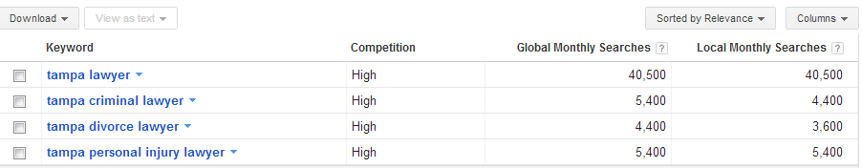
SEO: Research
Step 1: Figure out what Keyword Phrases.
Step 2: Build Authority & Relevancy.
Google Keyword Tool: https://adwords.google.com/o/KeywordTool

Slide 65
SEO: On-page & Architecture
Per-Page
Title Tags
Meta Description
Headlines
Page Names & Domain
Keyword Use on Page
Microformats
Office Address
Architecture
Webmaster Tools
Google Analytics
301 Redirects – Old Pages
Sitemap & XML Sitemap
Meta Keyword (don’t use)

Slide 66
SEO: Content
Topics
  Write about what People are Searching for.
Headlines
  Include Keyword Phrases, Don’t Get Spammy
Body Content
  Include Keyword Phrases, again, Don’t Get Spammy.
  Have Calls to Action to your Contact Page
Footer
  Office Address, Practices, Attorneys, and other Links
  Don’t Spam!

Slide 67
SEO: Links, Links and More Links
Social Media
  Twitter, Facebook, LinkedIn, Google+
Free Directories
  Open Directory Project – http://www.dmoz.org
  Avvo – http://www.Avvo.com
  Google Places – http://www.google.com/places/
  Bing Local – http://www.bing.com/local/
  Yahoo Local – http://local.yahoo.com/
  Manta – http://www.Manta.com
Customers / Vendors
Guest Blogging
Research Competitors at www.opensiteexplorer.org
Write Informative Content
PAID LINKS
Paid Directories
  Cornell Legal Information Institute – http://lawyers.law.cornell.edu/
  Yahoo! Directory – http://dir.yahoo.com
  BestoftheWeb.com – http://bestoftheweb.com/
  HG.org – http://www.hg.org/
  Findlaw.com – http://www.findlaw.com/
  Lawyers.com & Martindale.com – http://www.lawyers.com
Press Releases at PRWeb.com

Slide 68
SEO: Tips
Keyword Research is the First Step
Content Builds your Relevancy
Links Build your Authority
Track your Rankings Monthly
More Importantly, Track your Traffic

Slide 69
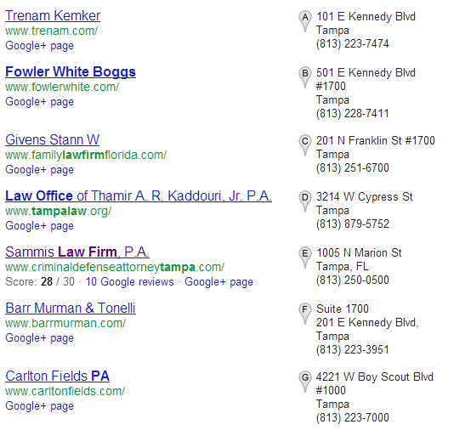
Local Search: Tampa Lawyer

Slide 70
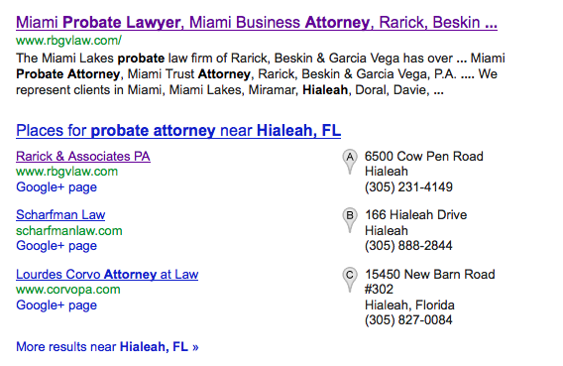
Who Cares About Places?
Google Does; So Should You.

Slide 71
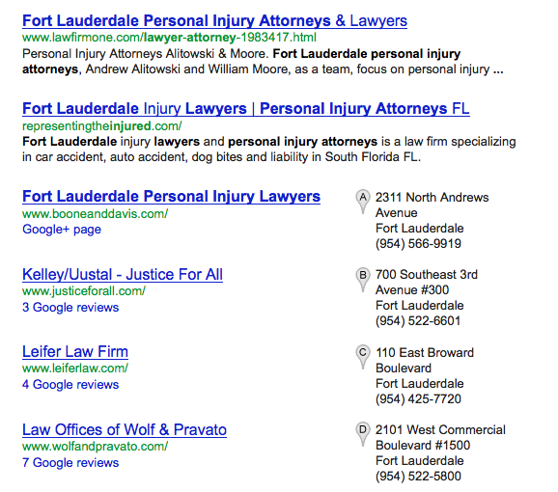
Overview Of Google Places
Google Places launched in September 2009 (replaced what was once called Google Local Business Center).
97% percent of consumers search for local businesses online.
Blended Place Search (merging local listings and organic listings). Keywords matter.

Slide 72
Local Search: Google Places
www.google.com/local/add/
On Most Common Searches for Lawyers (Law Firms and Attorneys too)
Sign Up For Google Local – It’s Free.
Claim your Profile First. Most Likely it is Listed.
Claim all Firm Profiles, Merge Them Together
Completely Fill out Profile
Get Citations from Other Directories with Office Addresses, Rank Higher

Slide 73
Ownership
Verify that no listing already exists.
Let’s repeat that: verify that no listing already exists.
If a listing does exist, claim the listing as the business owner and update accordingly.
99.99% of owners will have SOME TYPE OF LISTING. If you cannot find a listing, check again and check again. There is probably a listing available.
Notes:
Exhaust all searches before we register a new listing. Do queries on:
Name
Name + Short Form (sometimes a long firm name is shortened)
Name + City
Name + Practice
Phone + City
Phone + Practice
Use the attorneys names too

Slide 74
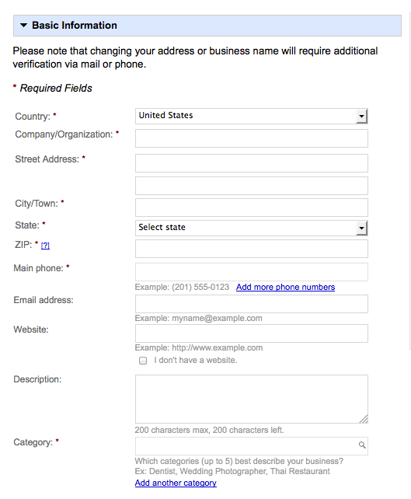
Setting Up A Listing
Account Creation
Company Name
Street Address
Phone
Email Address
Business Location
Description
Categories
Hours
Payment
Photos
Videos
Additional Details
Notes:
See outside notes

Slide 75
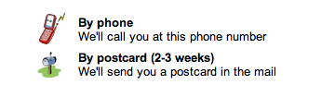
Verifying Your Listing
Phone - Verification PIN
Postcard: Dreaded 2- To 3-Week Wait

Slide 76
Gaining Authority And
Building Citations
Citations = Link Building
  Third-Party resources (yelp; yellowpages; etc)
Referring website must list the company information as it appears in the Places profile
Get reviewed on Google Places
How can your organic listing help?
  Use location-identifying keywords in page title
Notes:
DMOZ, Yahoo, BOTW, Yelp, Superpages, Citysearch, Yellowpages, Infogroup, Yahoo Local, Localeze, InsiderPages.
Competitor research (don’t mention the name WhiteSpark but describe what we get out of it)
Use keywords within image names
Use location-identifying keywords in page titles
That means that the company name and address have to be identical. While that doesn't seem too difficult a concept, consider this - if your business is listed at 300 S Main Street in the Places Profile, but someone cites the address on their website as 300 South Main Street, the value of that citation is diminished. One could believe that such a difference as negligible (S. vs. South), but in the realm of local search every detail matters
Google’s Venice update made it so that localization is honed in on even more. How so? United States vs. Fort Lauderdale

Slide 77
Local Search: Bing, Yahoo, Yellow Pages and Others
These Directories Provide Traffic, Too.
Bing - www.bing.com/local/us/
Yahoo – http://local.yahoo.com
Get Listed - http://getlisted.org/
It’s easy. Check Get Listed and See all your Listings. Claim each.

Slide 78
Local Search: Tips
Local is becoming More Important.
Personalized Search shows Local Results Automatically.
Build your Local Directory Profiles Online and Get Citations to Each Profile.

Slide 79
Newsletters
The List – This is your most important area. No Spam. Only People Who Opt-In.
The Content – Provide Useful Content. Not Just ME, ME, & ME.
The Platform – Use a Third-Party (www.mailchimp.com is who we use). ConstantContact and CampaignMonitor are good.

Slide 80
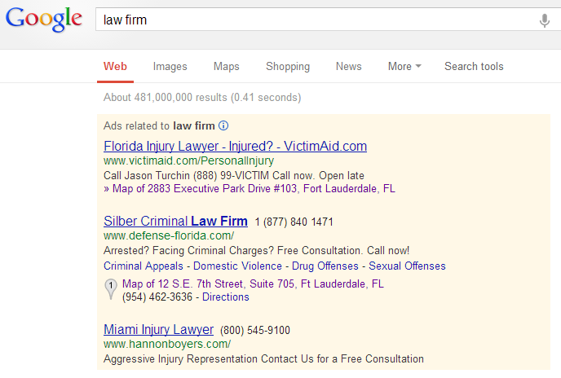
Internet Advertising & PPC

Slide 81

Internet Advertising: Google PPC
Quick and Easy Setup
Bidding Increased Significantly in Key Areas
Set Up Campaign
  Ads
  AdGroups
  Keywords
Create Unique Landing Pages
  The more targeted your ads and pages are, the higher your quality score. You can spend less on bids.
Budget $1,000 to $2,000 a month (at least).
  Some campaigns run through that in a week (or day).

Slide 82
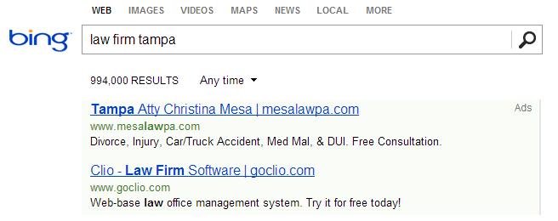
Internet Advertising : Bing PPC
Typical Budget is about 10% to 25% of Google Campaign.
Traffic is Usually 20% or Less of Google.
Same Overall Setup. Bid prices are less.

Slide 83
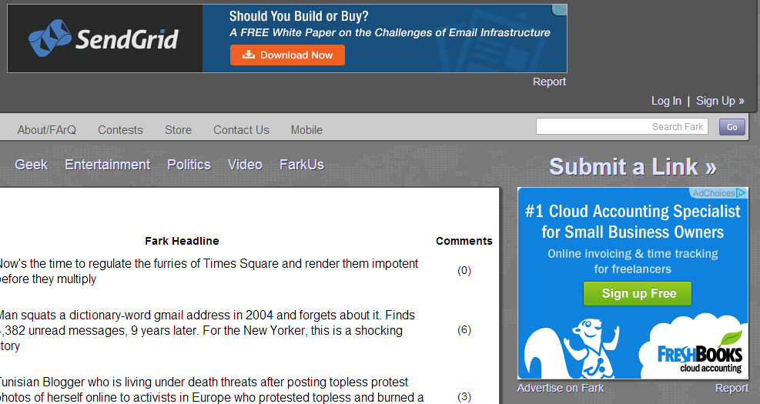
Internet Advertising: Retargeting
Great Way to Brand your Firm
User Sees your Ad on OTHER websites, only if they have visited your website.
I’ve been to these sites recently,
so the ads appear in more normal browsing.

Slide 84
Advertising: Tips
Use Google Adwords
If works, Expand to Bing and Retargeting Ads
Target your Audience
Set Budget Limits
Set Ad Variations & Landing Pages
Test, Test & Test

Slide 85

Social Media

Slide 86
Listen, Engage, Share.
What to Post
Frequency
  “I don’t have enough time.” Yeah, you do.

Slide 87
Social Media: Guidelines
Create your Profile
Create a Firm Profile (set you as an admin)
Add Content, Only Relevant Info
Follow, Circle, Like or Connect with People
Typically 50% will Follow You Back
Build your Audience over Time

Slide 88
Programs to Use to Communicate
(and make life easy)
Manual from Web or Mobile
Auto from Blog
Hootsuite
  A social media dashboard to monitor and manage multiple social media accounts.

Slide 89
Social Media: Others Tips
Where to Start
  Big 4 (Facebook, Twitter, Google+, LinkedIn)
  Go Where your Clients Are
  If on Pinterest.com Be There
  If on Yelp.com, Be There.
Rules of Social Networking
  Listen First, Then Engage
  Remember, It is Social Networking. Network!
  Post Valuable Content and Interact

Slide 90








Directories
Avvo
Justia
Findlaw
Martindale
Hg.org
About 50 to 100 other Directories

Slide 91

Videos
Hire a Videographer – Better Quality
Shoots Generally Last a Few Hours
Upload to YouTube & Website
Create a Video Sitemap

Slide 92

Videos
Don’t Use a Script. Interview Style.
Smile!
Topics about Questions Clients Have

Slide 93

Conversion Rates & Analytics
Use Google Analytics (Free & Easy to Install)
Try out Different Messaging & A/B Test

Slide 94
Key Areas to Review
Visitors (Overview, Demo, Behavior, Technology, Social & Mobile)
Advertising (AdWords)
Traffic sources (Sources, SEO)
Content (Overview)
Conversions (Goals)
Monthly Review Process & Testing

Slide 95
Final Thoughts
Internet Marketing: Everyone is Online.
Dedication: Timed devoted, dictates success.
Consistency: Become an authority. Write weekly.
Branding: Unified Brand & Clear Message.

