Slide 1
Ethics, Social Media & Your Web Presence
By Peter Boyd, Esq.
Attorney & General Guru
Notes:
Ethics - Learn the ethical responsibilities of social media, your website and overall web presence.
Monitor - Learn how to use, monitor and set goals for social media to market your practice on Google+, Facebook, Twitter, LinkedIn, Avvo, and other networks.
Increase - Learn how to increase your web presence beyond your website through social media, content, search and paid campaigns.

Slide 2
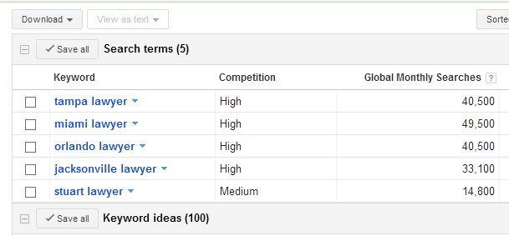
Why Internet Marketing?
Tens of Thousands of Searches Per Month!

Slide 3
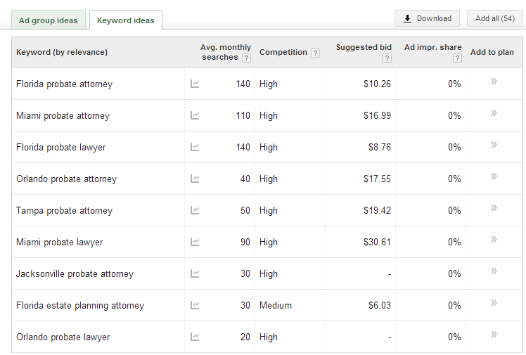
Specific Searches

Slide 4


Why Social Media?
It’s not just for teenagers.
The 45–54 year age bracket is the fastest growing demo on Facebook and Google+.
&

Slide 5

I am a Geek
Peter T. Boyd
My First Computer (circa 1986)
Attorney (Florida Bar 2001)
Practiced IP Law for a few years.
My True Love: Computers
Petitioned UF Law to allow Programming in C as a Foreign Language class (and won).
Founder of PaperStreet in 2001
Helped 750+ Law Firms
@peteboyd on Twitter
On Google+, FB and LinkedIn too

Slide 6
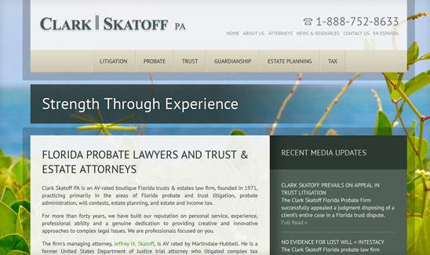
Online Results: Case Study #1
Firm: Clark Skatoff, PA
Type: Small Firm
Practice: Probate
Results:
2 to 4 inquiries / day
5 to 10 new clients / mo
Tactics: Website, SEO, Blogging, and Articles

Slide 7
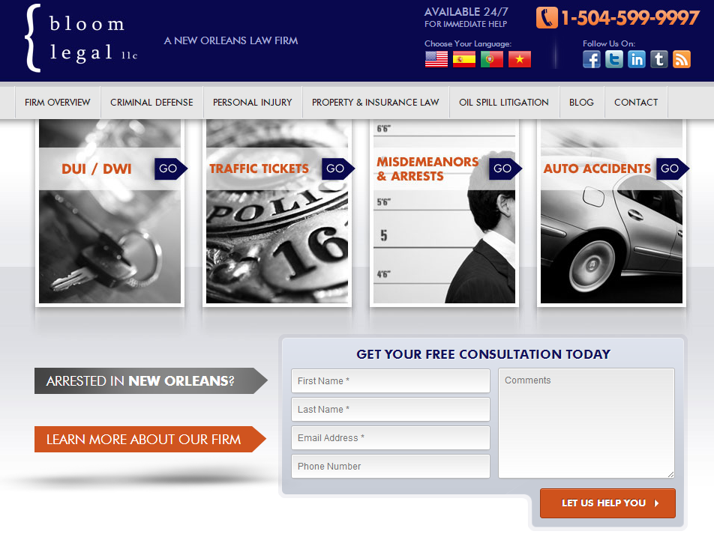
Online Results: Case Study #2
Firm: Bloom Legal
Type: Solo Practitioner
Practice: Criminal Law
Result:
2 to 3 inquiries/ day.
Tactics: Website, Blogging, Articles, Social Media, and Pay-Per-Click

Slide 8

Before We Start: The Bar Rules
All Advertisements are Covered, including:
  Websites
  Video, TV & Radio
  Print
  Brochures
  Direct Mail & Email
  Sanskrit, Signal Flags, Hieroglyphics, and Other Forms of Communication.

Slide 9
Bar Rules: Top 10 Things
Objectively Verifiable.
Don’t Use Superlatives Without Proof.
Testimonials are Allowed (with disclaimer).
Past Results are Allowed.
Websites & Social Media Same as Other Ads!
Requests for Info are Exempt from Filing / Review.
Websites do NOT need to be Reviewed.
Brochures are Requests for Information.
Burden of Proof on the Bar to Prove a Statement is False or Misleading.
Contact Information Needs to be on All Ads.

Slide 10
Bar Rules: Website
Names: Don’t use another lawyer’s or law firms name in the meta tags.
Location: Don’t falsely represent your locations.
Practice Areas: Don’t represent that you practice in an area.
Hidden Text: Would almost always be inherently false and misleading.
Google Adwords: Lawyers may not purchase the name of another lawyer or law firm as a key word.
Don’t have to be filed! In fact, they won’t take your whole website, but you can file a few pages for $150 a page for review.
Notes:
The Committee is of the opinion that certain website content and the use of certain internet search engine optimization techniques can be false, deceptive or misleading conduct that is prohibited by Rule 4-7.13.22. Examples include “hidden text” or “meta tags” that use another lawyer’s or law firm’s name without a proper purpose, a false representation that a law firm has an office in a particular location when the lawyer does not have an office at that location, or representing that a lawyer handles cases in an area of practice that the lawyer or firm does not practice.

Slide 11
Bar Rules: Bona Fide Office
Must disclose at least one office.
Misleading if you list cities where you do not actually have an office though.
What is Bona Fide?
  Regular and Continual Service
  Little or no Full Time Staff
  Lawyer not present regularly
  Signage? Staff? Services?
Virtual Office: Available for Consultation. Satellite. Limited Service

Slide 12
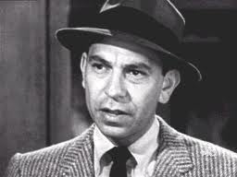
Bar Rules: Verifiable & Superlatives
Objectively Verifiable
  Basically, Don’t Lie.
  If you make a claim,
  back it up!
Don’t Use Superlatives, “Just the Facts, Ma’am.”

Slide 13
Bar Rules: Verifiable & Superlatives
Good Examples:
Practicing for 10 years.
Licensed in 3 States.
Helped 150 people with their foreclosures.
Our Goal is blah, blah, blah….
Uh Oh!
Best Lawyer in Town.
The Toughest Lawyer around.

Slide 14
Bar Rules: Testimonials
Go ahead and place on website.
Make sure they have a disclaimer and are verifiable.
Make sure your client’s agreed.
Make sure your client’s don’t use any key superlatives (i.e. “best”).

Slide 15
Bar Rules: Big Wins!
Yes, you can include your big case wins
(aka $1,000,000 Settlement)
However, don’t omit any information.
  Did you deduct your fees and costs? Net Amount?
  Was it obtained by default? Uncontested?
  Can you prove it? What if nondisclosure?
  What if it fell short of actual damages?
If needed, put in a disclaimer.

Slide 16

Bar Rules: Banner Ads
All Rules: Must comply with all Bar Rules.
Filing: Must be Filed.
City: Must contain a city.
Name: Must contain lawyer or law firm name.
Don’t lie, omit, or mislead.

Slide 17

Bar Rules: Social Media
Purely Social – No Rules. Party On!
Promoting the Law Firm –Obey the Rules.
  Objectively Verifiable
  Don’t Mislead, Omit or Lie.
  Don’t solicit directly
  unless a current relationship.
  Not responsible for comments
Social Media is not required to be filed.
Must have Contact Information on profiles (and in the posts of Twitter).

Slide 18

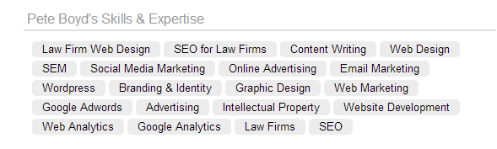
Bar Rules: LinkedIn
“Skills and Expertise”
You can have a LinkedIn Profile.
Staff position is that you may not list your areas of practice under the header Skills and Expertise if you are not board certified.

Slide 19

Bar Rules: Video Sharing (aka YouTube)
Personal Videos: Party On!
YouTube Reaches More Viewers in the 18-34 demographic than any cable network.
Promoting the Law Firm: Obey the Rules.
SCA is of the opinion that videos posted solely on video sharing sites are information at the request of the prospective client and therefore not required to be filed with The Florida Bar for review.

Slide 20

Websites
This is your:
- Content
- Search
- Blogs
- Social Media
- Videos
- Everything Else
Your website is the
base of all your marketing

Slide 21

What is Responsive Design?
189 million of Facebook’s users are ‘mobile only’.
Most of our clients see 20% to 40% of their traffic from mobile.

Slide 22

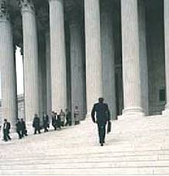

Websites: Images
Use Royalty Free, Stock Photos
Don’t Steal Images from Google Search
Where to Go: www.istock.com, www.gettyimages.com, www.corbis.com, www.veer.com, and others.
Key Message on Home Page with Good Image
Don’t use Clichés (Gavels, Courthouse Steps)

Slide 23
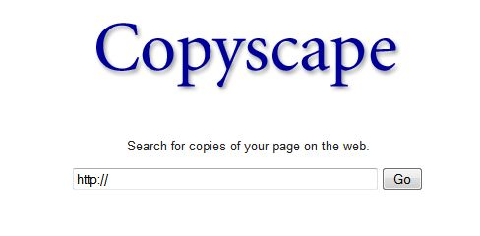
Websites: Content
Goal
  Become an Authority.
  Unique. Don’t Duplicate.
  Make it Contextually Relevant
  for what you want to be.
  Don’t Copy or Steal.
  Have a Site Structure.
What to Write About
  Don’t just Write about You, You and You.
  Write what your Clients Want to Read
  Facts, Q&A, How To, Case Studies, Top 10 Lists.

Slide 24
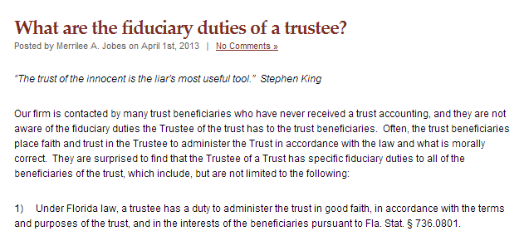
Websites: Blogs
Topics
News
  Court Rulings, Legislation, Industry News, Trends, Cases
  Informative
Case Law Analysis
Client Questions
  FAQs
  Process
  Announcements
Firm News, Success, Awards
Schedule
Publish Daily.
Yes. Publish Daily.
Very Least Publish Weekly
Big Long List - http://www.paperstreet.com/blog/5047

Slide 25
Websites: 3 Ways to Improve
Message: Have a clear message & tagline.
Imagery: Imagery that represents your brand.
Content: Place important content on home page. Create an organized structure.

Slide 26
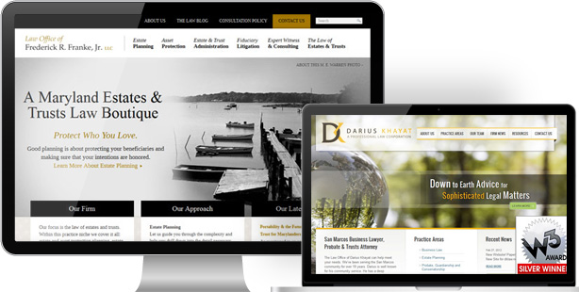
Websites: Your Message
A Clear Message & Powerful Tagline.

Slide 27
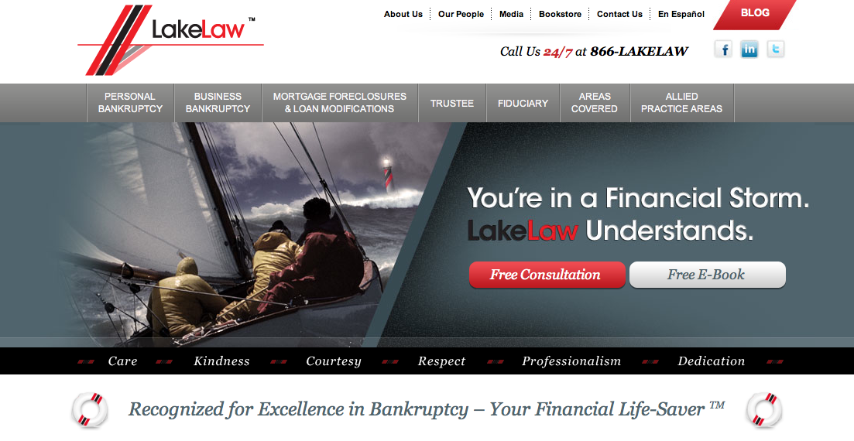
Websites: Your Imagery
Feature Imagery that Represents your Brand.

Slide 28
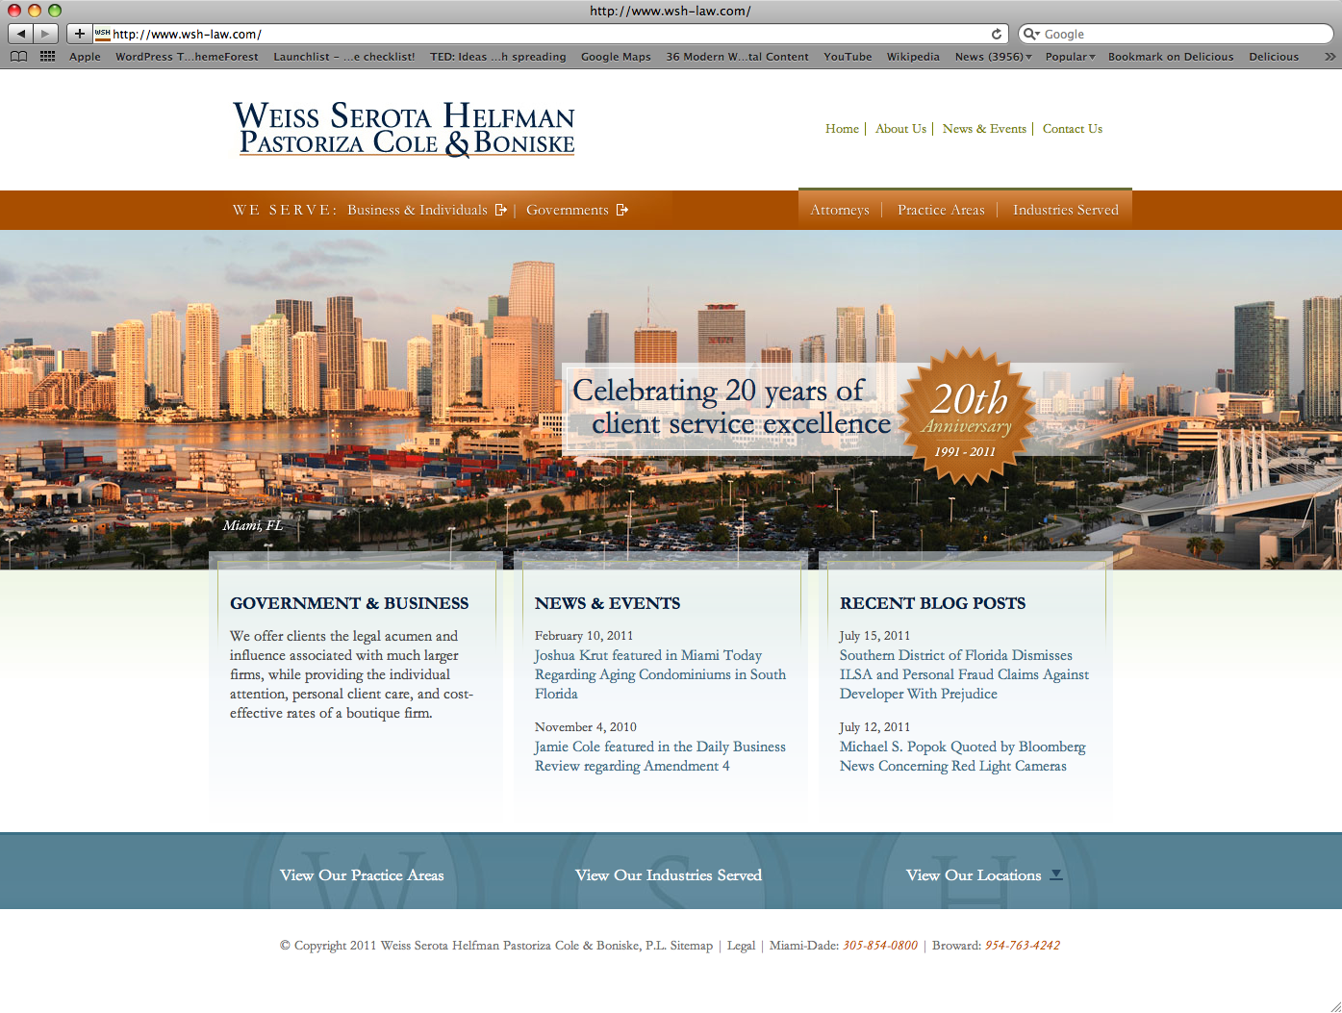
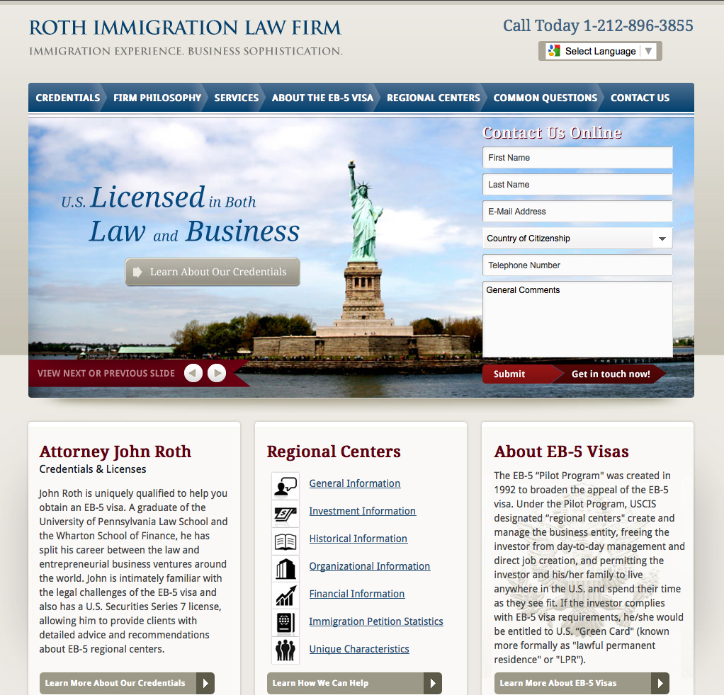
Websites: Your Content
Most Important Content on the Home Page & Organize your Website!

Slide 29
3 Ways to Improve Marketing
SEO: Build Links to your website and properly tag your site’s web pages.
Social: Integrate Social Media into your web presence.
Content: Write. Write. Write.

Slide 30
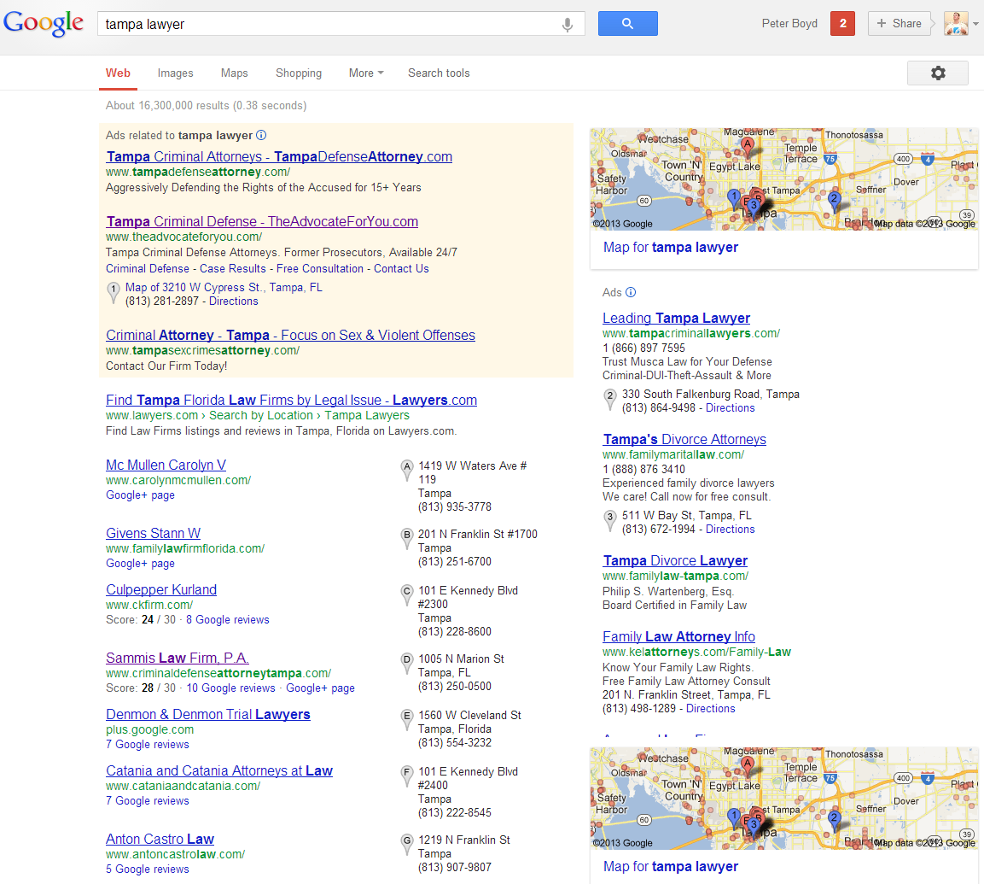
Marketing: SEO
You Need to
Be Here!!!!

Slide 31
Why SEO?
It works. Top Rankings get you Free Traffic.
It’s easy. Simple Changes to your Site.
It’s Cost Effective and can be Measured.
It’s More Effective than Pay-Per-Click. (8x)
It helps you Build a Compliant Website.
It Forces you to Write and Network.

Slide 32
SEO: Research
Step 1: Figure out what Keyword Phrases.
Step 2: Build Authority & Relevancy.

Slide 33
SEO: On-page & Architecture
Per-Page
Title Tags
Meta Description
Headlines
Page Names & Domain
Keyword Use on Page
Microformats
Office Address
Architecture
Webmaster Tools
Google Analytics
301 Redirects – Old Pages
Sitemap & XML Sitemap
Meta Keyword (don’t use)

Slide 34
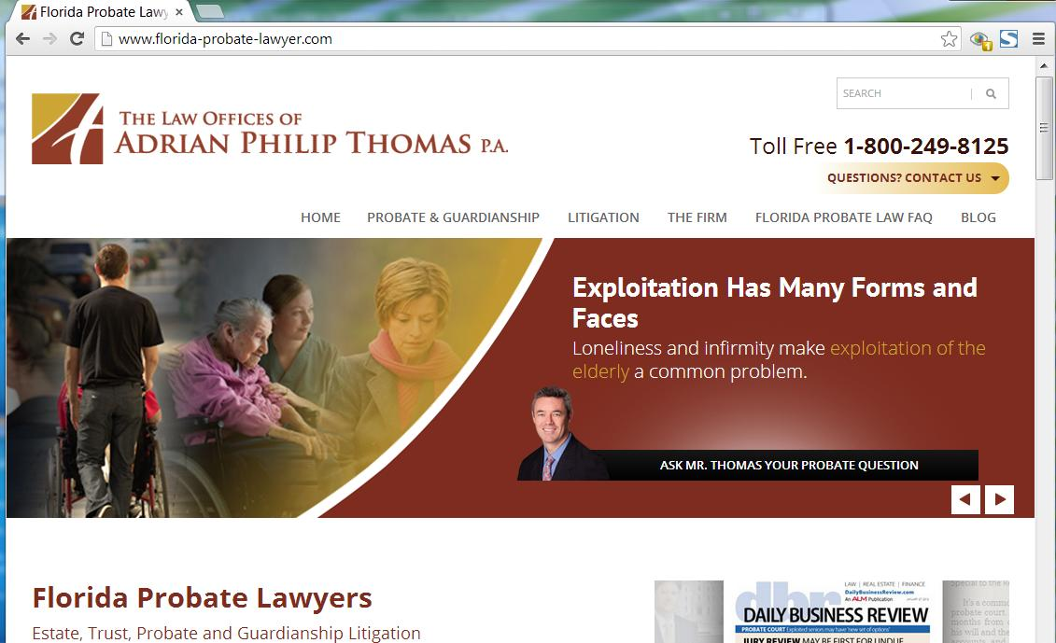
Title Tag

Slide 35
SEO: Content
Topics
  Write about what People are Searching for.
Headlines
  Include Keyword Phrases, Don’t Get Spammy
Body Content
  Include Keyword Phrases, again, Don’t Get Spammy.
  Have Calls to Action to your Contact Page
Footer
  Office Address, Practices, Attorneys, and other Links
  Don’t Spam!

Slide 36
SEO: Authority
Social Media
  Twitter, Facebook, LinkedIn, Google+
Free Directories
  Open Directory Project – http://www.dmoz.org
  Avvo – http://www.Avvo.com
  Google Places – http://www.google.com/places/
  Bing Local – http://www.bing.com/local/
  Yahoo Local – http://local.yahoo.com/
  Manta – http://www.Manta.com
Customers / Vendors
Guest Blogging
Research Competitors at www.opensiteexplorer.org
Write Informative Content
PAID LINKS
Paid Directories
  Cornell Legal Information Institute – http://lawyers.law.cornell.edu/
  Yahoo! Directory – http://dir.yahoo.com
  BestoftheWeb.com – http://bestoftheweb.com/
  HG.org – http://www.hg.org/
  Findlaw.com – http://www.findlaw.com/
  Lawyers.com & Martindale.com – http://www.lawyers.com
Press Releases at PRWeb.com

Slide 37
SEO: Local Search
Local is becoming More Important.
Google+ and Local
Bing - www.bing.com/local/us/
Yahoo – http://local.yahoo.com
Get Listed - http://getlisted.org/
It’s easy. Check Get Listed and See all your Listings. Claim each.

Slide 38








SEO: Good Directories
Avvo
Justia
Findlaw
Martindale
Hg.org
About 50 to 100 other Directories

Slide 39





Marketing: Social Media

Slide 40
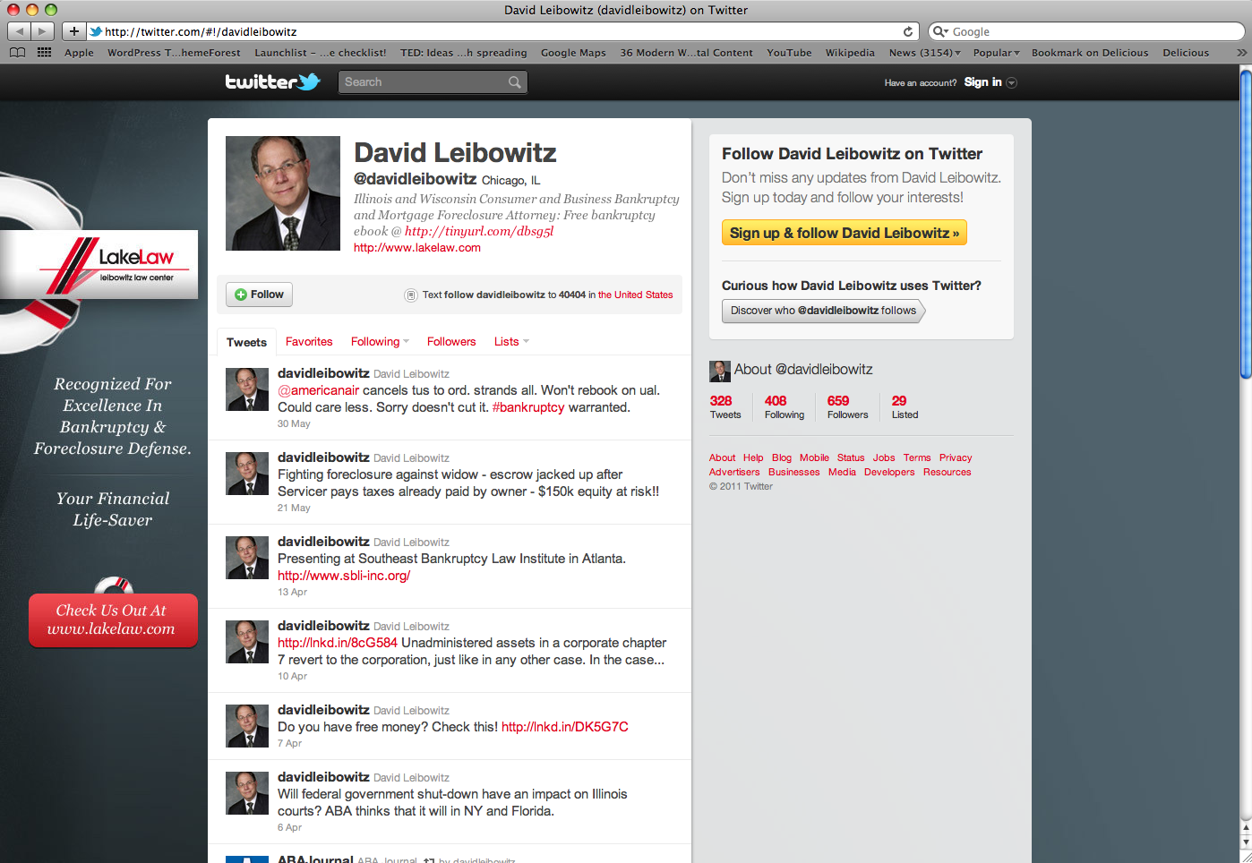
Listen, Engage, Share.
What to Post:
News and info.
Frequency:
1x to 3x
Time:
I don’t have
any time?
Yes. You do.

Slide 41
Social Media: Guidelines
Create your Profile
Create a Firm Profile (set you as an admin)
Add Content, Only Relevant Info
Follow, Circle, Like or Connect with People
Typically 50% will Follow You Back
Build your Audience over Time

Slide 42

Programs to Use to Communicate
(and make life easy)
Manual from Web or Mobile
Auto from Blog
Hootsuite: A social media dashboard to monitor and manage multiple social media accounts.

Slide 43
Social Media: Others Tips
Where to Start
  Big 4 (Facebook, Twitter, Google+, LinkedIn)
  Go Where your Clients Are
  If on Pinterest.com Be There
  If on Yelp.com, Be There.
Rules of Social Networking
  Listen First, Then Engage
  Remember, It is Social Networking. Network!
  Post Valuable Content and Interact

Slide 44
Marketing: Content
  Write often. Become an Authority.
  Cover legal news / events in your area.
  Create in-depth articles that help.
  Have the most exhaustive resource in your practice.

Slide 45
Content: You are Too Wordy
Readers Skim!
Use headlines, sub-heads, bullet points and short paragraphs for skimming.
Make your content client-centric.
Use tables, charts, maps, lists, images, and diagrams, rather than text.
Use images and icons, rather than words.

Slide 46
Content: Duplicate & Structure
Unique content is key.
Don’t steal and don’t regurgitate.
Pyramid Structure
3 Levels are usually enough, sometimes 4.
50 or 100 Links per Page
Standard Pages:
Home, Practice, Attorneys, Blog, About, & Contact
Advanced Pages
Industries, News, Media, Case Studies, Articles, Directory of Resources, Lists, Charts, Industry information, and more

Slide 47
Content: Ideas
About Us
Practice Areas and Info
Service Areas and Info
Products and Info
Lists
Top 10
News
Articles
Recommendations
Directory of Resources
Research Articles
Interviews
Free Tools
Expositions
Humor
Reviews
Video, Audio
Surveys
Contests
Trends
Advice Columns
Charts & Graphics

Slide 48
Home Work: 10 Days to Success
Google Places - Get Signed Up http://www.google.com/business/placesforbusiness/
Google+ Signup. Fill out your Profile.
Add 50 Followers to your Circles (most likely half will follow-you back)
Avvo.com - Get Signed Up. Fill out your Profile!
Getlisted.org - Check your listings. Add as many as possible.
Facebook.com - Signup. Setup your page.
LinkedIn - Signup and Join Some Groups (listen)
Twitter - Signup. Tweet. Follow.
More Local - Signup for Bing and Yahoo Local.
Social. Add all your social buttons to your website.
Blog - write one good article. Post that article on all your new networks.

Slide 49
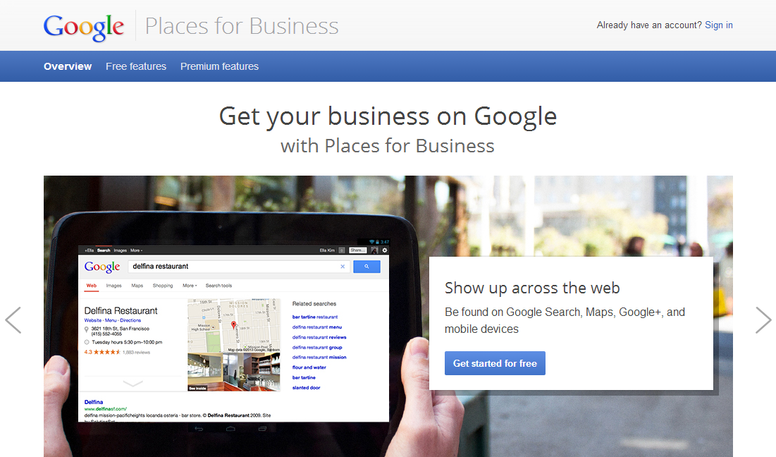
1. Google Places – Get Signed Up!

Slide 50
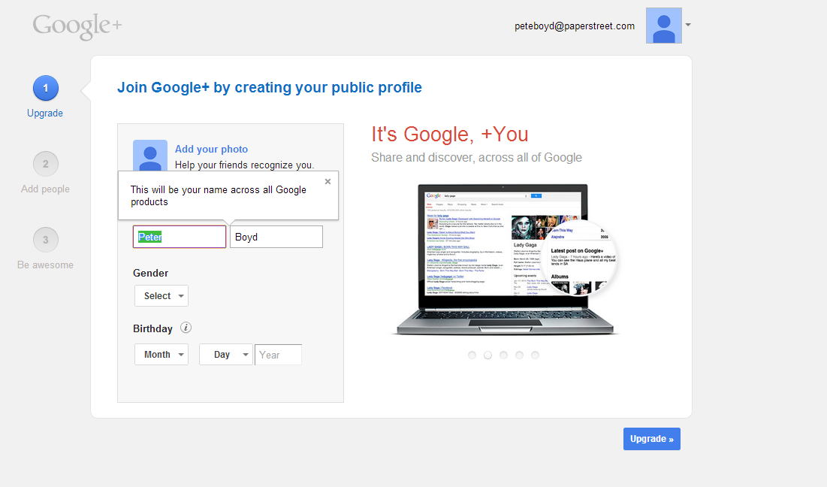
2. Google Plus – Sign Up – Follow

Slide 51
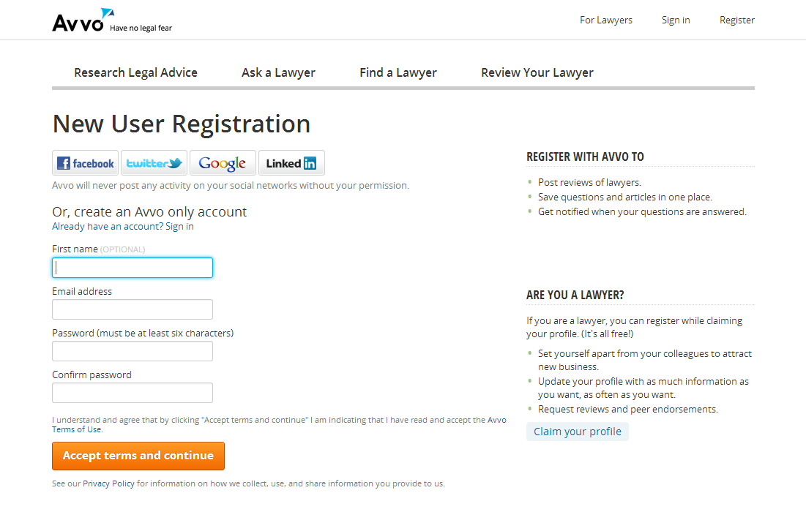
3. Get Listed on Avvo

Slide 52
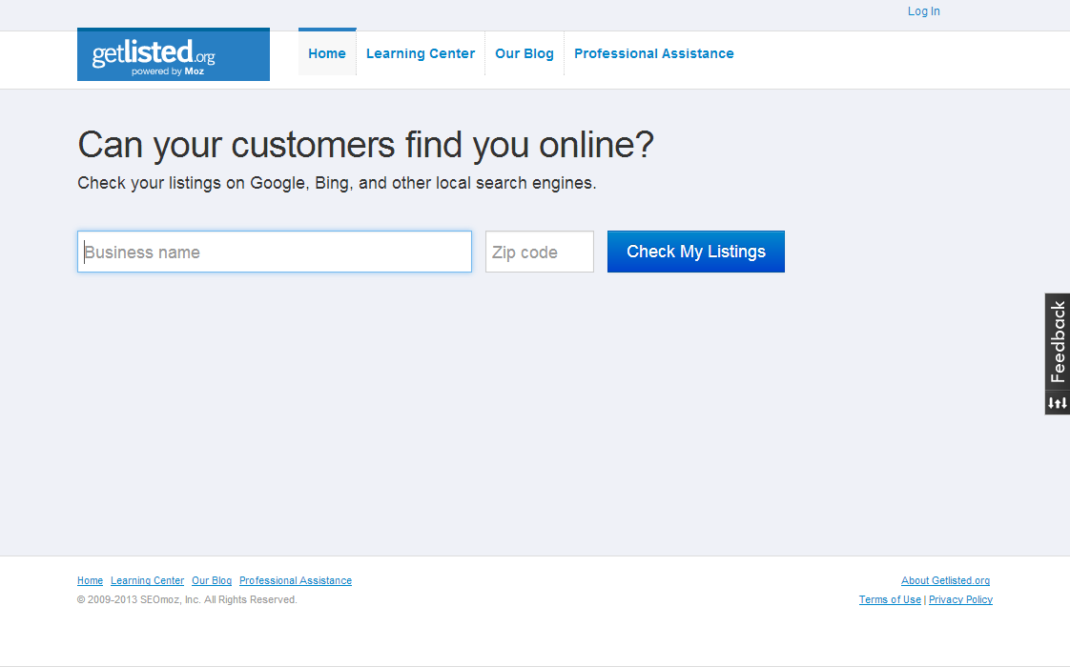
4. Check GetListed.org

Slide 53
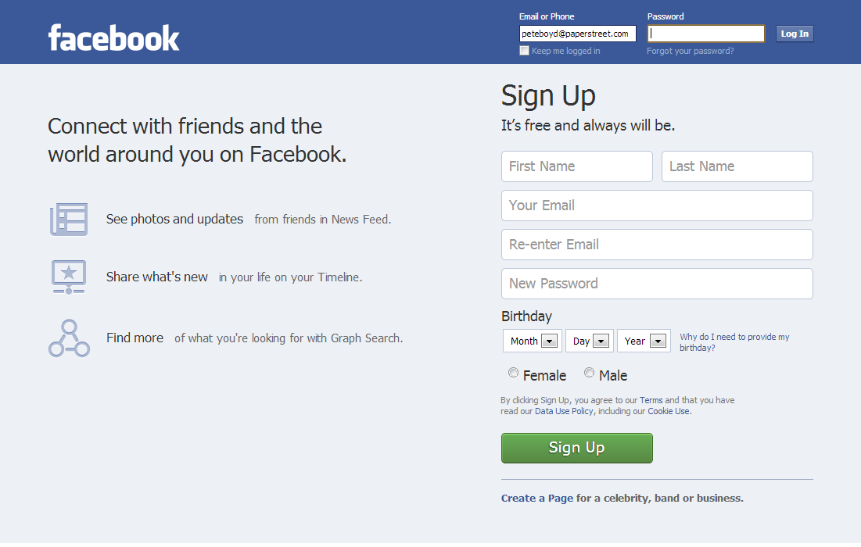
5. Facebook

Slide 54
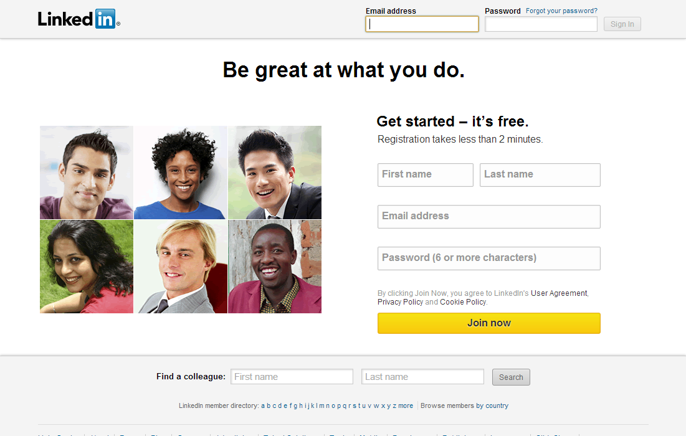
6. LinkedIn

Slide 55
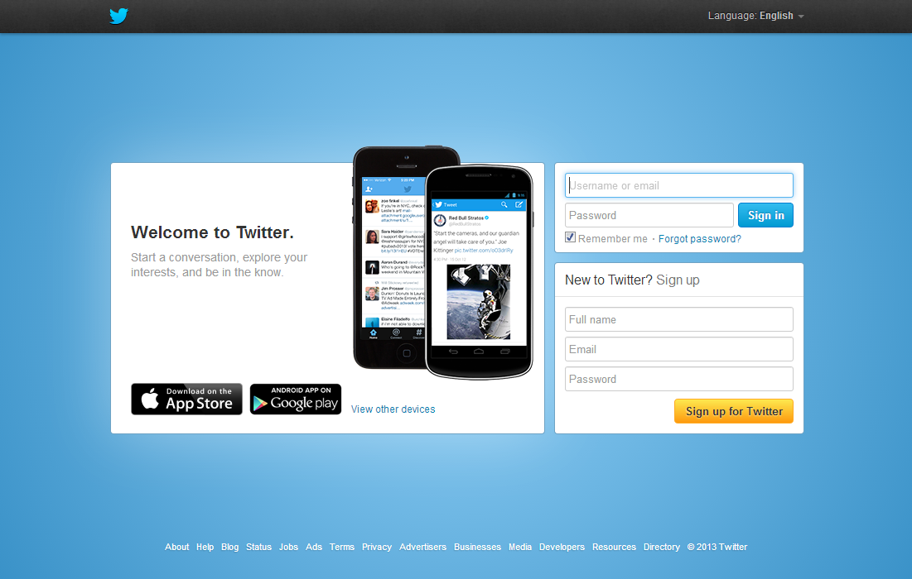
7. Twitter

Slide 56
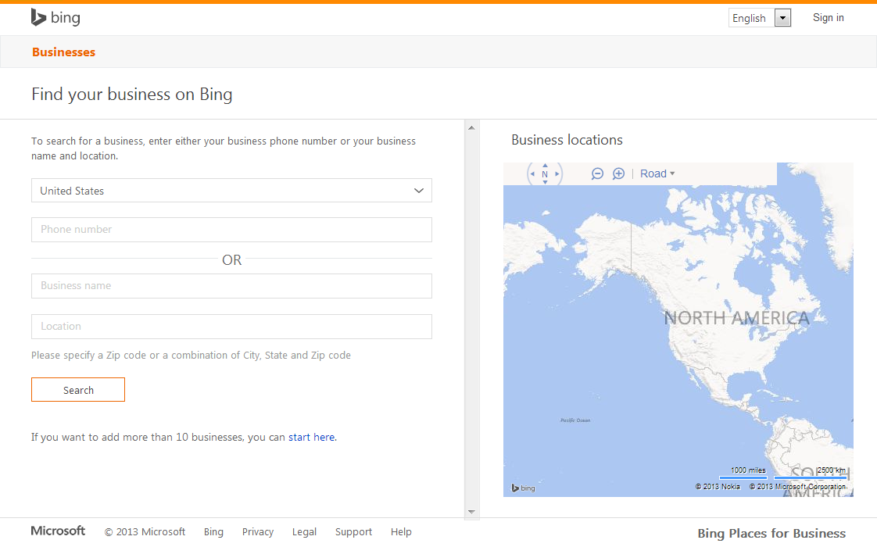
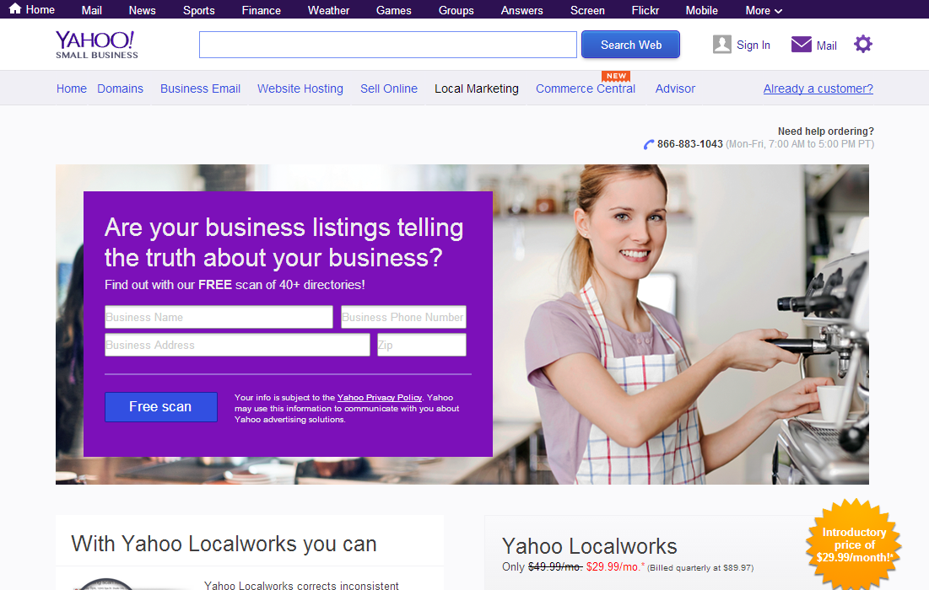
8. Bing & Yahoo

Slide 57
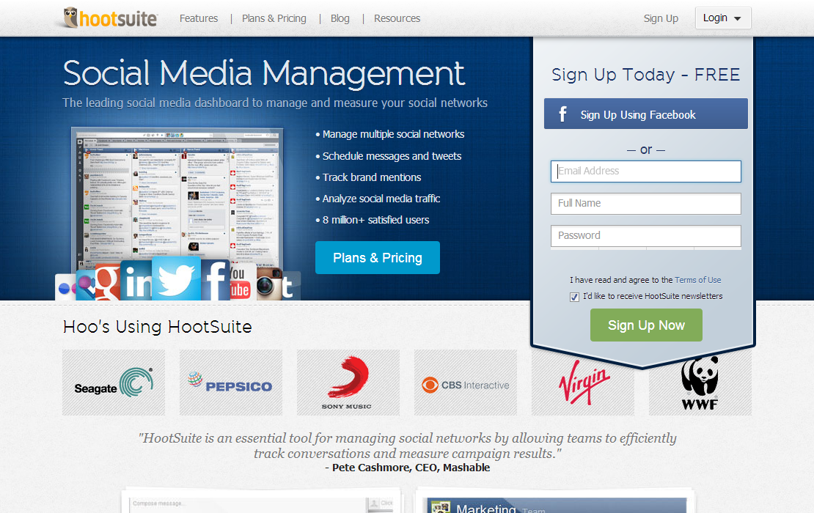
9. Post via HootSuite

Slide 58
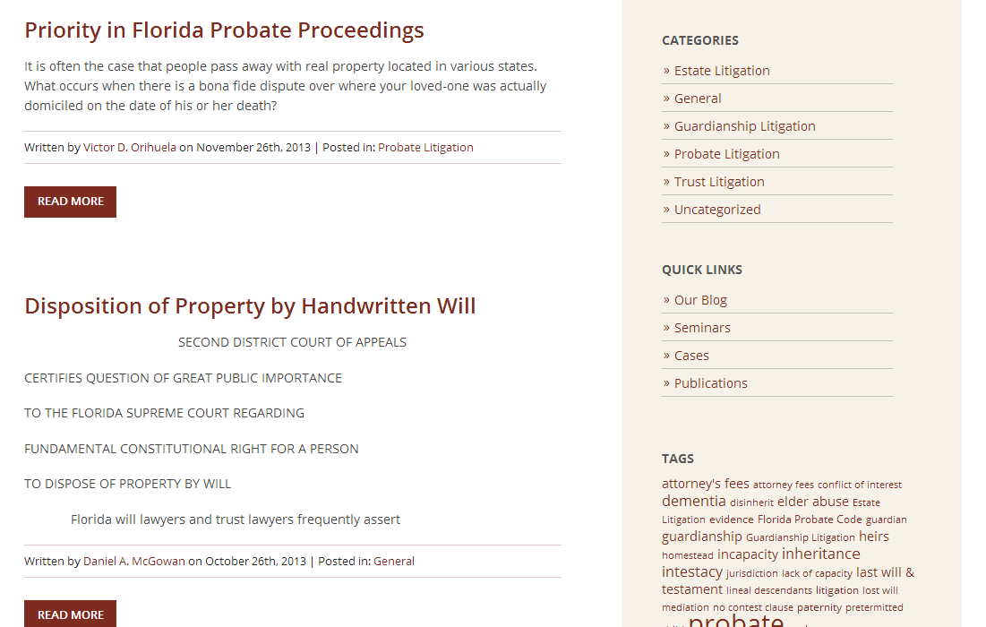
10. Blog!

Slide 59
Thanks!
By Peter Boyd, Esq.
Attorney & General Guru

